Slide 1
States of matter
Physical pharmacy
Noor Alsaadi
Lecture 2

Slide 2
THERMAL ENERGY
Thermal energy is the energy of a body arising from motion of its atoms or molecules. It is directly proportional to the temperature of the substance. It is the measure of average kinetic energy of the particles of the matter and is thus responsible for movement of particles. This movement of particles is called thermal motion.

Slide 3
INTERMOLECULAR FORCES vs THERMAL INTERACTIONS:
When molecular interactions are very weak, molecules do not cling together to make liquid or solid unless thermal energy is reduced by lowering the temperature. Gases do not liquify on compression only, although molecules come very close to each other and intermolecular forces operate to the maximum. However, when thermal energy of molecules is reduced by lowering the temperature; the gases can be very easily liquified.

Slide 4
THE GASEOUS STATE :
This is the simplest state of matter. Throughout our life we remain immersed in the ocean of air which is a mixture of gases. We spend our life in the lower most layer of the atmosphere called troposphere, which is held to the surface of the earth by gravitational force.

Slide 5
The thin layer of atmosphere is vital to our life. It shields us from harmful radiations and contains substances like dioxygen, dinitrogen, carbon dioxide, water vapour, etc

Slide 6
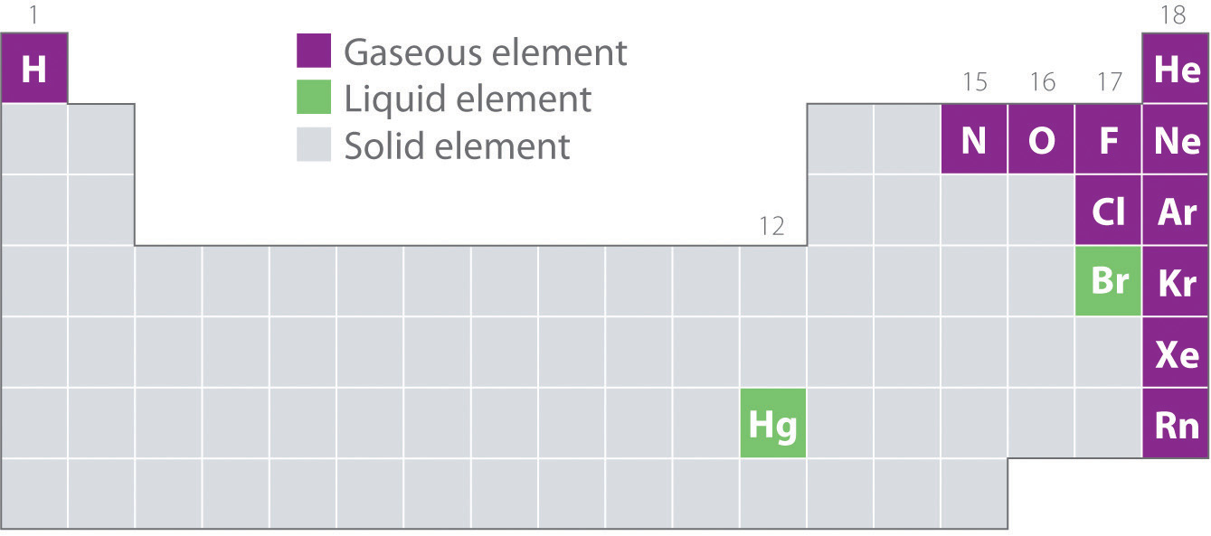

Slide 7
The gaseous state is characterized by the following physical properties :
• Gases are highly compressible.
• Gases exert pressure equally in all directions.
Gases have much lower density than the solids and liquids.
• The volume and the shape of gases are not fixed. These assume volume and shape of the container.
• Gases mix evenly and completely in all proportions without any mechanical aid.

Slide 8
THE GAS LAWS :
Boyleís Law (Pressure - Volume Relationship)
On the basis of his experiments, Robert Boyle reached to the conclusion that at constant temperature, the pressure of a fixed amount (i.e., number of moles n) of gas varies inversely with its volume. This is known as Boyleís law. Mathematically, it can be written as p ∝ 1/V ( at constant T and n)

Slide 9
⇒ p = K * 1/V
where k is the proportionality constant. The value of constant k depends upon the amount of the gas, temperature of the gas and the units in which p and V are expressed.

Slide 10
If a fixed amount of gas at constant temperature T occupying volume V1 at pressure p1 undergoes expansion, so that volume becomes V2 and pressure becomes p2, then according to Boyle’s law :
P1 V1 = P2 V2 =constant
P1 /P2 = V2 / V1

Slide 11
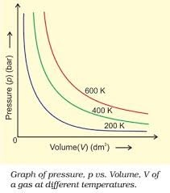

Slide 12
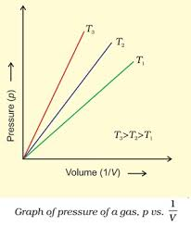

Slide 13
the previous 2 graphs shows two conventional ways of graphically presenting Boyle’s law. The first graph is of equation PV=K at different temperatures. The value of k for each curve is different because for a given mass of gas, it varies only with temperature. Each curve corresponds to a different constant temperature and is known as an isotherm (constant temperature plot).

Slide 14
The second graph represents the graph between
p and 1/V
It is a straight line passing through origin. However at high pressures, gases deviate from Boyle’s law and under such conditions a straight line is not obtained in the graph.

Slide 15
Experiments of Boyle, in a quantitative manner prove that gases are highly compressible because when a given mass of a gas is compressed, the same number of molecules occupy a smaller space. This means that gases become denser at high pressure.

Slide 16
Problem 5.1
A balloon is filled with hydrogen at room temperature. It will burst if pressure exceeds 0.2 bar. If at 1 bar pressure the gas occupies 2.27 L volume, up to what volume can the balloon be expanded ?
Solution According to Boyle’s Law p1V1 = p2V2
If p1 is 1 bar, V1 will be 2.27 L
If p2 = 0.2 bar, then
V2 = p1*V1 /p2
V2= 1bar * 2.27L /0.2bar
=11.35 L
Since balloon bursts at 0.2 bar pressure, the volume of balloon should be less than 11.35 L.

Slide 17
Charlesí Law (Temperature - Volume Relationship):
several experiments are done on gases independently to improve hot air balloon technology.
Their investigations showed that for a fixed mass of a gas at constant pressure, volume of a gas increases on increasing temperature and decreases on cooling. They found that for each degree rise in temperature, volume of a gas increases by 1 /273.15 of the original volume of the gas at 0 °C.

Slide 18
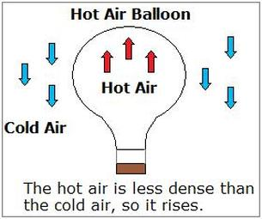

Slide 19
Charlesí law, which states that pressure remaining constant, the volume of a fixed mass of a gas is directly proportional to its absolute temperature.
Charles found that for all gases, at any given pressure, graph of volume vs temperature (in celsius) is a straight line and on extending to zero volume.

Slide 20
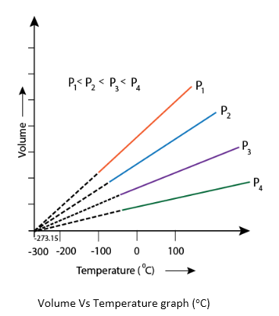

Slide 21
Each line of the volume vs temperature graph is called isobar.
All gases obey Charles’ law at very low pressures and high temperatures.

Slide 22
Problem 5.2 :
On a ship sailing in pacific ocean where temperature is 23.4 °C , a balloon is filled with 2 L air. What will be the volume of the balloon when the ship reaches Indian ocean, where temperature is 26.1°C ?
Solution:
V1 = 2 L , T2 = 26.1 + 273 = 299.1 K ,
T1 = (23.4 + 273) K = 296.4k
From Charles law : V1/T1 = V2/T2
V2 = 2L * 299.1k / 296.4k =2.018L

Slide 23
Gay Lussacís Law (PressureTemperature Relationship) .
It states that at constant volume, pressure of a fixed amount of a gas varies directly with the temperature.
Mathematically : p/T = constant = K3

Slide 24
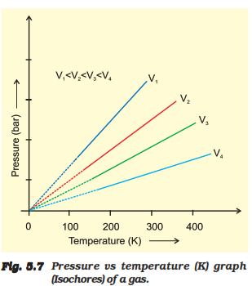

Slide 25
Avogadro Law (Volume - Amount
Relationship)
It states that equal volumes of all gases under the same conditions of temperature and pressure
contain equal number of molecules.
This means that as long as the temperature and pressure remain constant, the volume
depends upon number of molecules of the gas
or in other words amount of the gas.

Slide 26


Slide 27
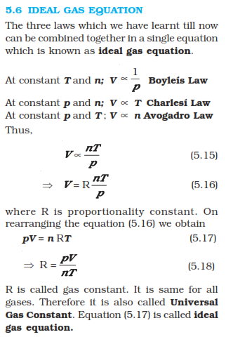

Slide 28
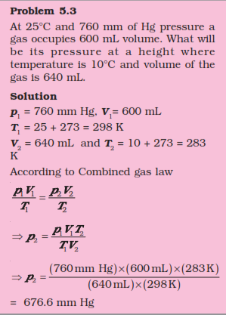

Slide 29
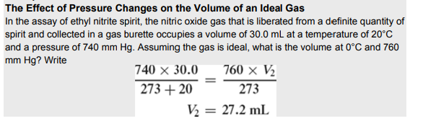

Slide 30
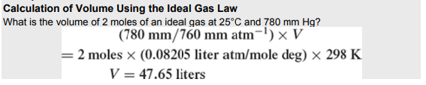

Slide 31
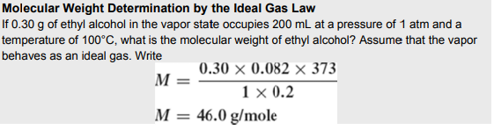

Slide 32
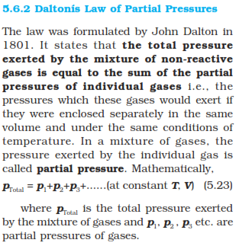

Slide 33
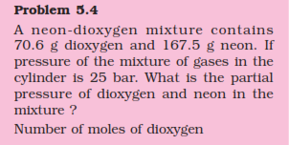

Slide 34
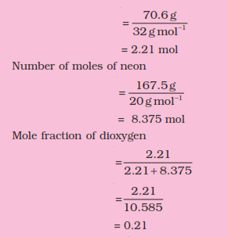

Slide 35
