Slide 1

Buffered
and
Isotonic
Solutions
Martin physical pharmacy, chapter 8

Slide 2
Overview
 Buffered Solutions
Definition
Buffer
Buffer
Buffer
Equation
Capacity
in Biological Systems
Pharmaceutical Buffers
 Isotonic Solutions
Introduction Isosmotic
Solutions Isotonic
Solutions Measurement
of Tonicity
Methods of Adjusting Tonicity

Slide 3
Buffered Solutions

Slide 4
Pharmaceutical Buffers
Buffer solutions are widely
aqueous pharmaceutical
used to adjust pH of
solutions
to
ensure:
1.Tissue irritation prevention
2.
Optimum therapeutic effect
3.
Maximum drug stability
4.
Maximum drug solubility

Slide 5
In Vivo
biologic
buffer
systems
Blood
Lacrimal
fluid
Urine

Slide 6
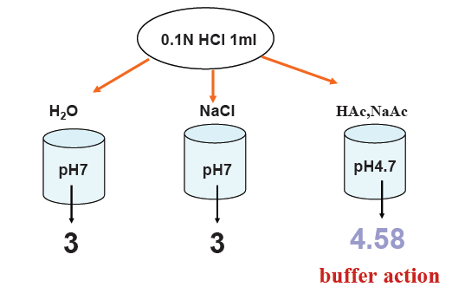
Definition

If a small amount of a strong
acid or base is added to water or NaCL solution, the pH changed considerably.

If 1 ml of 0.1 N HCL solution is
added to water, the pH change from 7 to 3 but if added to 0.01 M solution
containing equal quantities of
acetic acid and sodium acetate the pH change only
0.09 unit.

Slide 7
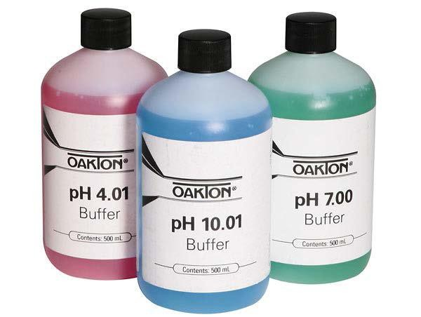
Definition
Buffers are mixtures of compounds
that resists changes in pH upon the addition of small quantities of acid
or alkali.
A buffer is composed of a weak
acid (HA) and its salt(conjugate base A⁻) or a weak base (B) and its salts (conjugate acid BH⁺⁾).

Slide 8


Definition
 When a weak acid exist in solution (e.g., acetic acid)
dissociate to give the conjugate base of that acid (in this case
OAc−) and H₃O⁺.

Slide 9

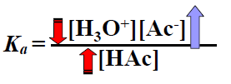
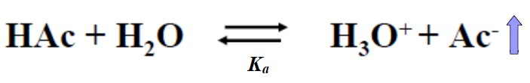
Definition
 when Sodium acetate is added to acetic acid solution, the
acetate ion supplied by the salt increases the [Ac-]
NaAc
Na⁺+ Ac⁻
 To reestablish the constant Ka, [H₃O⁺] is instantaneously
decreased, by shifting the equilibrium in the direction of the
reactants (the ionization of acetic acid is repressed upon the addition of the common ion [Ac-]).

Slide 10


Definition

If more
H⁺
is added to this solution, it simply shifts
the equilibrium to the left, absorbing H⁺, so the
[H⁺] remains unchanged.

If
H⁺
is removed (e.g. by adding OH-) then the
equilibrium shifts to the right, releasing the pH constant
H⁺
to keep

If too much
H⁺
is added, the equilibrium is shifted
all the way to the left, and there is no longer any
more Ac⁻ to “absorb” H⁺.

At that point the solution no longer resists change in pH; it is useless as a buffer.

Slide 11

Buffer
Equation
(weak
acid
and
its
salt)
 Most OAc⁻ will come from the salt NaOAc, therefore;
 Since weak acid is slightly ionized

Slide 12
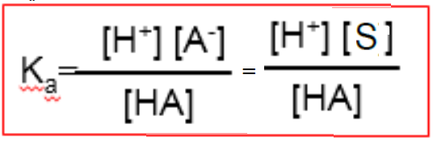
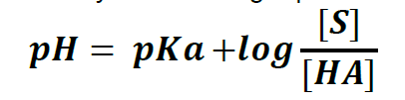
Buffer Equation
(weak
acid
and
its
salt)
For
weak
acid:
The pH is calculated
by the following equation:
The equation above is named Henderson-Hasselbalch equation
buffers of weak acids.
for

Slide 13

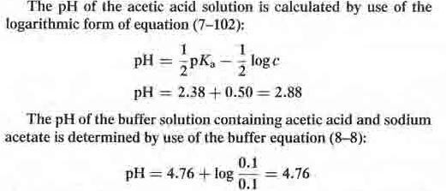
Example
The pH
of ACETIC ACID SOLUTION IS INCREASED 2 UNITS

Slide 14
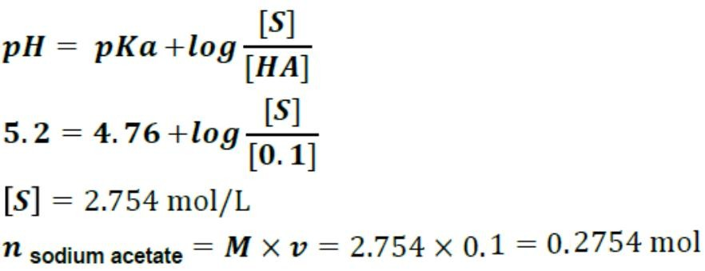
Example

Slide 15

Buffer Equation (weak base and
its salt)
Buffer solutions are not commonly prepared
and their salts because of:
from weak
bases
1. Volatility and instability of the bases
2.Dependence of their pH to pKw ,which temperature changes.
is often affected by
For a weak Base (�)and its salt(𝑺):

Slide 16


Example

Slide 17

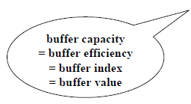
Buffer capacity (β)
Approximate Equation
 The magnitude of the resistance of a buffer to pH changes
 Buffer capacity is the quantity of strong acid or base that can be added
to change the
 A equation for
pH of one liter of buffer solution by one pH unit.
calculating buffer capacity(��):
𝜟�: number of moles of strong acid or base per liter of buffer (gram equivalents/Liter).
����H: change in pH.

Slide 18

Buffer capacity (β)
-
o⁺
HAc
0.1
+
AC
D. -
+
H
3
HAc
(0.1- 0.01)1
+
NaOH
0.01
NaAC
(0�1+ 0.. 01)
+
^{H}2⁰
•
Befo¹re
he
addition
of
Nao H
[salt]
pH pKa + log
[add]
= 4.76
•
After the addi- ion of NaOH
P^{H-·pKa + log}
[saJ_t] +
l[base]
^{[b}· a.s¹e]
.
[ ac:1^{-d}·
]
= 4.85
-
•
!3=
-�-^{B}
-=
0.0
0.09
= 0.1
�_pH

Slide 19
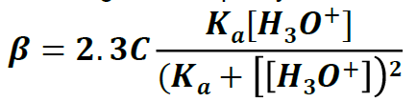
Buffer
 More exact
capacity (β) (Exact Equation)
Equation for calculating buffer capacity:
 C is the total buffer concentration (the sum of the molar concentrations of the acid and
the salt).
 this eqn. is applicable to dilute solutions until about C total < 0.35.
 This equation allows the calculation of buffer capacity at any pH (even when no acid or
base has been added to the buffer).
 an increase in the concentration of the buffer components (� ) results in a greater buffer
capacity (𝜷).

Slide 20
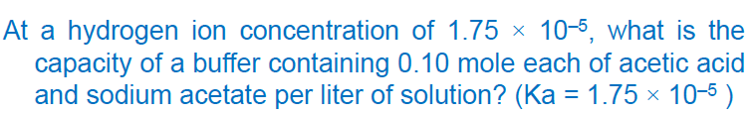
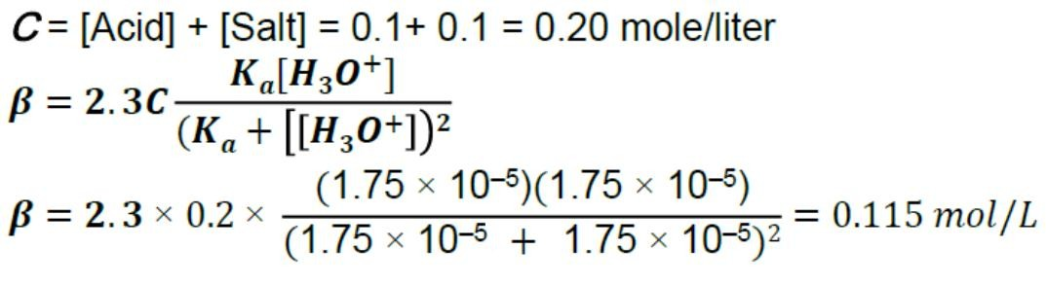
Example

Slide 21
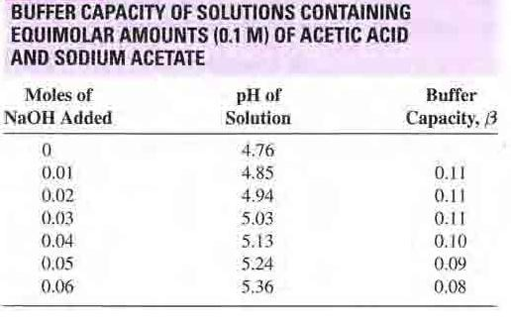
Factors affected buffer
capacity

1) The buffer capacity is not a fixed
value and depend on the amount
base added
of
➢
With addition of more NaOH, the
buffer capacity decrease rapidly
➢
When sufficient base was be added to
convert the acid completely the
solution no have acid reserve and
buffer capacity.
➢
The greatest capacity before base
was added.

Slide 22
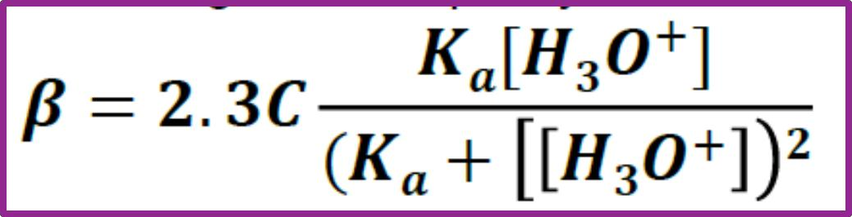
Factors affected buffer capacity
2) value of the ratio [salt]/[acid]
The greatest capacity(βmax) occurs where
pH= pKa or [salt]/[acid] = 1
[H⁺]=Ka or

Slide 23


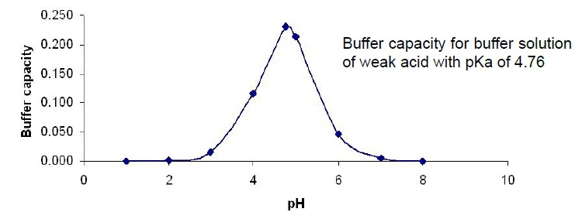
Maximum Buffer Capacity
The maximum buffer capacity occurs where
pH=pKa, or, in equivalent terms, where [H3O⁺]=Ka.
this eqn. is applicable to dilute solutions until about Ctot = 0.35.
Because of interionic effects, buffer capacities do not exceed a value of
0.2

Slide 24
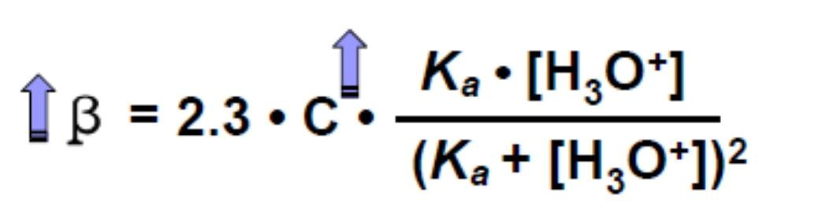
Factors affected buffer capacity
3) the magnitude of the individual concentrations
buffer components
(buffer capacity increases as the salt and acid concentrations are increased).
of the

Slide 25
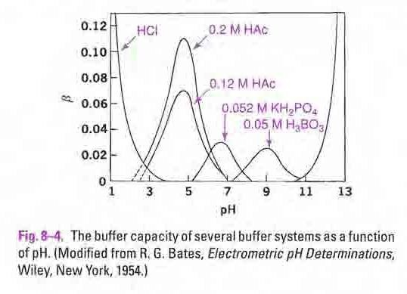

Slide 26
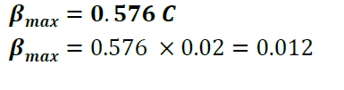
Example

Slide 27


Some factor influence buffer pH
The addition of neutral
salt
to
buffer
Dilution of buffer
Temperature

Slide 28
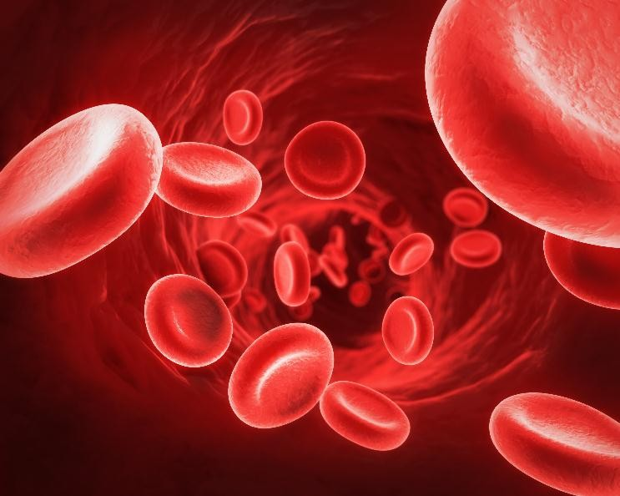
In Vivo biologic buffer systems
•Blood (pH 7.4)
① Primary buffers :Plasma;
NaHCO3--H2CO3, Na2HPO4--NaH2PO4, protein
acid and can combine with base)
② Secondary buffers :Erythrocytes;
hemoglobin-oxyhemoglobin, K2HPO4--KH2PO4
(acts
as
➢ Buffer capacity of blood is 0.028 (sum of buffer capacity of
all buffers)
➢ Life threatening for the pH of blood is when going to below
6.9, and above 7.8
➢ The pH of blood in diabetic coma is below 6.8

Slide 29
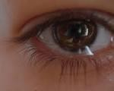
In
Vivo biologic buffer systems
•Lacriminal fluid
✓ pH: 7.4 (range 7-8 or slightly higher)
✓ Tear with higher buffer capacity
✓ Allowing a dilution of 1:15 with neutral distilled water before an alteration of pH.
✓ So that a reasonably wide pH range of medicines can be tolerated.
✓ It is generally thought that the eye drops within the pH range 4-10 will not harm
cornea.
✓ However, discomfort and flow of tear will occur below the pH 6.6 and above 8.

Slide 30
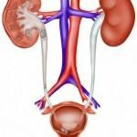
In Vivo biologic
buffer
systems
•Urine
-pH: 6.0 (range 4.5 –7.8)
-below normal…hydrogen
the kidney.
ions are excreted by
-above pH 7.4…hydrogen ions are retained by
action of the kidney.

Slide 31
Pharmaceutical Buffers
Buffer solutions are used in pharmaceutical
formulation
Examples:
particularly
in
ophthalmic
preparations
Gifford
Sorensen
The Clark-Lubs
PBS (phosphate
buffered
saline)
 Acetate, lactate, citrate,….

Slide 32
Pharmaceutical Buffers
Gifford
suggested two stock solutions
of:
1) boric acid and
2) monohydrated sodium carbonate
pH values from about 5 - 9.

Slide 33
Pharmaceutical Buffers
Sorensen buffer
proposed a mixture
sodium phosphate pH 6 to 8.
of salts
of:

Slide 34
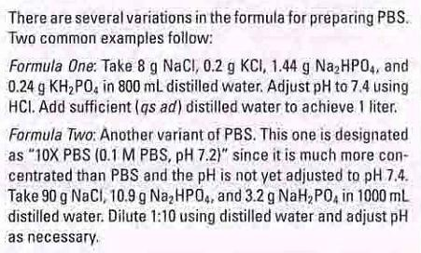
Pharmaceutical Buffers
PBS (phosphate buffered saline)
1X PBS

Slide 35
Steps of Preparing of buffer solution
The following steps should be used in preparing
systems:
buffer
We determine the pH and buffer capacity of our
buffer

Slide 36
Steps
of Preparing of buffer solution
Determination of pH
1)
2)
3)
4)
Drug solubility
Drug Stability
Minimize Tissue irritation optimum therapeutical effect

Slide 37
Determination of pH
1) Drug solubility
The influence of buffering on
base:
the solubility of the alkaloidal
• at a low pH a base is predominantly in the ionic form
which is usually very
soluble in aqueous media
• as the pH is raised
more undissociated
more undissociated base is formed
base, which has poor water solubility,
leading to precipitation of this form from solution.
• Therefore, the solution should be buffered at sufficiently
low pH

Slide 38
Determination of pH
2) Drug Stability
Buffer is used to prevent changes
✓ alkalinity of the glass
in pH due to the
✓ acidity of CO2 from dissolved air
• Solutions as Thiamine hydrochloride may be sterilized
by
autoclaving without decomposition if the pH is below 5 ; above
this pH thiamine hydrochloride is unstable.
• The stability of emulsions is pH dependent.

Slide 39
Determination of pH
3) Minimize Tissue irritation
Tissue irritation due to large pH differences between: pH of
the solution administered and the pH of the physiological
fluid

Slide 40
Determination of pH
4) optimum therapeutic effect

The pH for maximum stability and solubility of a drug for ophthalmic use may be far below
that of the optimum therapeutic effect?
1-
solution of the drug can be buffered at a low buffer capacity
2-
adjust pH to be a compromise between that of optimum stability and the pH for maximum
therapeutic action.
 Yet, when the solution is instilled in the eye, the tears participate in the gradual
neutralization of the solution and the conversion of the drug from the physiologically inactive form to the undissociated base the base can then readily penetrate the lipoidal
membrane.
 As the base is absorbed at the pH of the eye , more of the salt is converted into base to preserve the equilibrium, hence the alkaloidal drug is gradually absorbed.

Slide 41
Steps of Preparing of buffer solution
Determination of buffer capacity
1)
2)
3)
Minimize Tissue irritation
Maximum stability
optimum therapeutic effect

Slide 42
Determination of buffer capacity
1) Maximize stability:
Multi dose formulations, emulsion,…
2) Minimize Tissue irritation
Tissue irritation due to large pH differences
between:
pH of
the
solution administered and the pH of the physiological fluid
Tissue irritation is minimized:
(a) The lower the buffer capacity of the solution
(b) The smaller the volume used for a given concentration.

Slide 43
Determination of buffer capacity
1) Minimize Tissue irritation

Parenteral solutions for injection into the blood stream are usually not buffered
or they are buffered to a very low capacity so that the buffers of the blood may bring them within the physiological pH range.

Oral solution in buffer with lower buffer capacity was absorbed better from GI
rather than those formulated in buffer with higher buffer capacity


For ocular solution
phosphate buffer produced irritation in the eyes of a number of subjects when used outside the pH range of 6.5 to 8 , Boric acid solution of pH 5 produced
no discomfort in the eyes of the same subjects. Why?
Because of the very low buffer capacity of boric acid compared to that of
the phosphate buffer
Nasal drug: isotonic with low buffer capacity



Slide 44
Determination of buffer
1) Minimize Tissue irritation
capacity
(buffer capacity of 0.01 to 0.1 is sufficient)

Slide 45
Steps of Preparing of buffer solution
After determination pH and buffer capacity
The following steps should be used in preparing systems:
buffer
1)Select a weak acid having a pKa approximately
equal to the pH wanted to insure maximum buffer capacity. Pka= pH

Slide 46
Steps of Preparing of buffer solution
Factors of some importance in the choice
buffer:
of
pharmaceutical
1)
2)
3)
4)
5)

Availability of chemicals
Sterility of the final solution.
Stability of the drug and buffer
Cost of materials.
Free from toxicity.
on aging.
( For example, a borate buffer, because of its toxic effects, cannot be
used for a solution to be administrated orally or parenteral) and mainly
used in ophthalmic preparations, and preparations intended for topical application.

Slide 47
Steps
of
Preparing
of
buffer
solution
Summary of Buffer Systems System pKa pH Range
acetic acid/acetate 4.76 3.5-5.7
glycine/glycinate 7 6.5-7.5
citric acid/citrate 4.74 2.5-6
lactic acid/lactate 3.8 3.0-5.0
phosphoric acid/phosphate 7.2 6.8.2
glutamic/glutamate 9.67 8.2-10.2
 Buffers for
parenteral solutions: Phosphate, citrate, acetate
 Amino acid buffers, especially histidine, have become buffer systems of choice
for controlling solution pH of monoclonal antibody solutions.

Slide 48
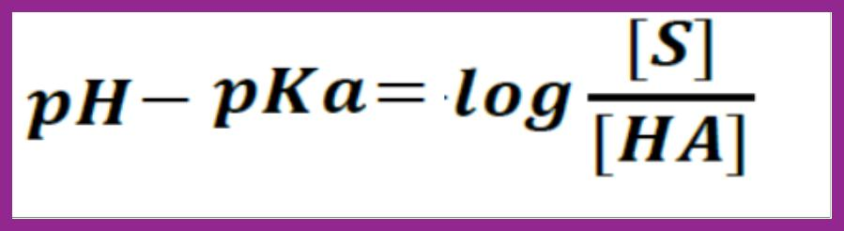
Steps of Preparing of buffer solution
 2) From the buffer equation, calculate the ratio of salt and weak acid required to obtain the desired pH.
 The buffer equation is satisfactory for approximate calculation
within the pH of 4-10.

Slide 49
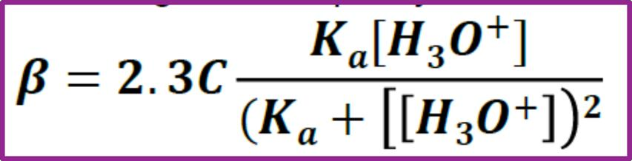
Steps of Preparing of buffer solution
 3) Consider the individual concentrations of the buffer salt and
acid
needed
to
obtain
a
suitable
buffer
capacity.
 A concentration of 0.05 to 0.5 molar is sufficient and buffer
capacity of 0.01 to 0.1 is sufficient we could select from 0.02-0.2.
 4) Finally, determine the pH and buffer capacity of the completed
buffered solution using a pH meter.

Slide 50
Example

Slide 51
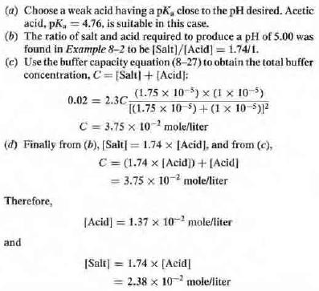
Example

Slide 52
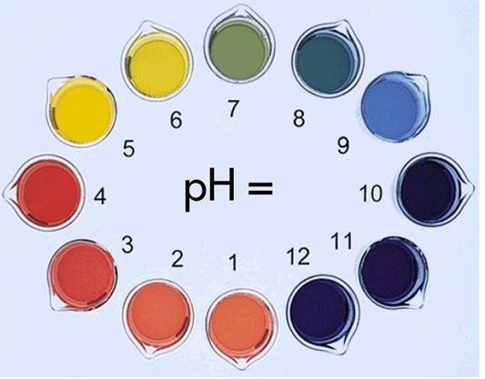
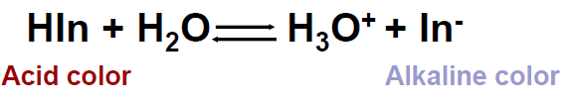
pH indicator
pH indicators are weak acids or weak bases that exhibit color change as
their
pH.
degree
of
dissociation
varies
with
METHYL RED

Slide 53
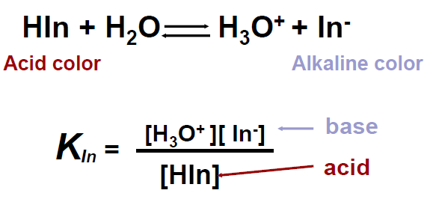

pH indicator

Slide 54

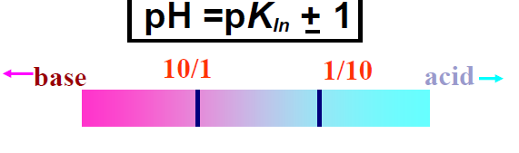
pH

indicator
Just as a buffer shows its greatest efficacy when pH=pKa , an indicator exhibit its middle tint when pH=pK_{ln} OR [base]/[acid]=1

The most efficient indicator range is about 2 pH unit, pH=pKln±1

From experience, one cannot discern a change from the acid color
to the salt color the ratio of [base] to [acid] is about 1 to 10

Slide 55
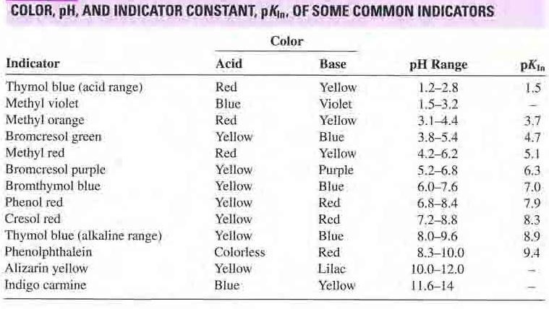
pH indicator

Slide 56
pH indicator
Characteristics
of colorimetric method
① less accurate
② less expensive than electrometric method
③ difficult to apply for the unbuffered pharmaceutical
preparation (change the pH -indicator itself is acids or base)
④ error may be introduced by the presence of salts & proteins

Slide 57
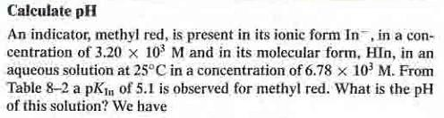


Slide 58
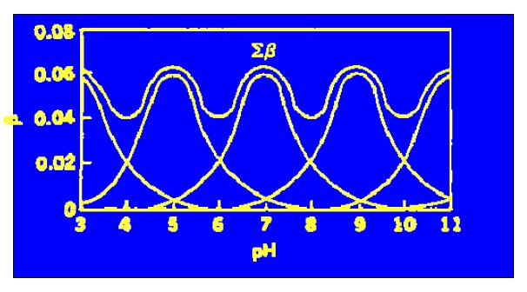
Universal Buffer
Universal Indicators
 Total buffer capacity of a universal buffer (combination of several buffers)
 (combination of several buffers)

Slide 59
Isotonic
Solutions

Slide 60
Isotonic Solutions
Introduction
Isosmotic Solutions
Isotonic Solutions
Measurement of Tonicity
Methods of Adjusting Tonicity

Slide 61
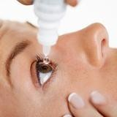
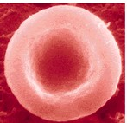

Introduction
In addition to carrying out pH adjustment, pharmaceutical solutions that are meant for application to delicate body membranes should also be adjusted to approximately the same osmotic pressure as that of the body fluids.


Isotonic solutions cause no swelling or contraction
of the tissues and produce no discomfort when instilled in the eye, nasal tract, blood, or other
body tissues.

Isotonic sodium chloride NaCl(0.9%) is a familiar
pharmaceutical example of such a preparation.

Slide 62
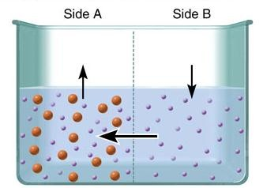
Osmosis
Diffusion
of water across a semipermeable
membrane
➢ Water moves down its concentration gradient,
from an area of higher water concentration to an area of lower water concentration.
➢ Therefore, the net movement of water is
from an area of lower solute concentration to an area of higher solute concentration.

Slide 63
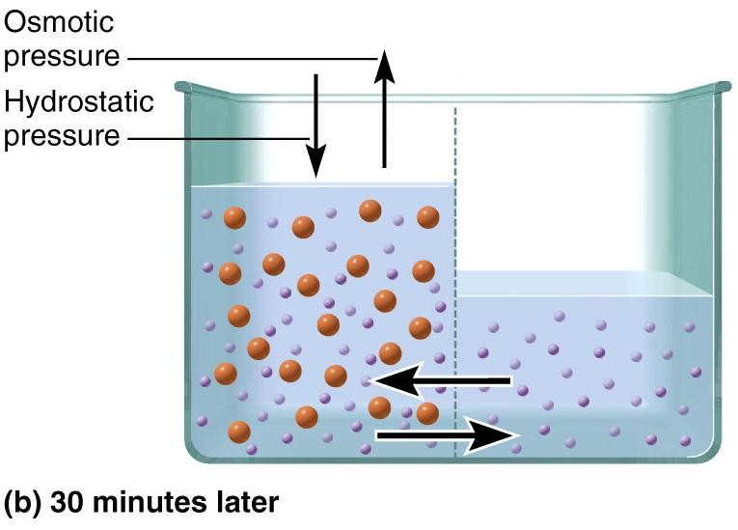
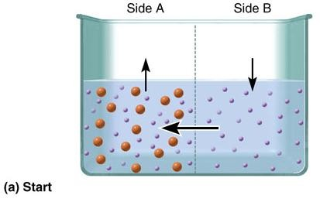
Osmosis
No net movement because
hydrostatic
pressure = osmotic pressure
unit of measurement for osmotic pressure: mm Hg

Slide 64
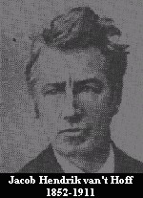
Colligative Properties of Solution
1. Osmotic pressure
Van't Hoff equation
π=iRTC
π: osmotic pressure
R is the gas constant,
T is The absolute temperature
C is the concentration in moles
per liter.
i is the number of ions into which the molecule dissociated
as the
solution was diluted

Slide 65

Osmolality and osmolarity
 The unit to express the amount of osmotically active particles in a
solution is the osmole or milliosmole:
 Where 𝒏 is the number of species in to which the solute is dissolved
 1Osmol=10³ mOsmol
 Osmolarity is the number of osmoles of solute per L of solution
 Osmolality is the number of osmoles of solute per kg of solvent
the osmolarity of biological fluid is 308 mosmol

Slide 66
Osmolarity
➢ Osmolality is a measure of the number of particles in one kilogram of
solvent.
 osmolarity is a measure of the number of particles in one liter of solution.
for a dilute solution: osmolality ≈ osmolarity = osmoles / (L solution)
Osmolality is more accurate than osmolarity, because volume varies with temperature, but weight does not. But, you are more familiar with calculating molarities than molalities.
[For the purposes of this course assume complete dissociation of any solutes.]
 e.g., 1 mole of glucose ⇒ 1 osmole of glucose
 e.g.,
1 mole of NaCl
⇒
2 osmoles NaCl
(1 mole Na⁺ + 1 mole Cl⁻)

Slide 67
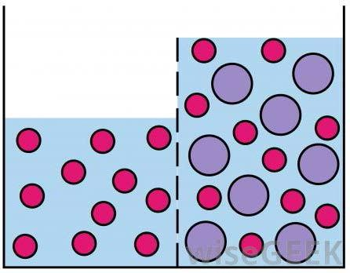
Isosmotic Solutions
 When two solutions are separated by a perfect semipermeable
membrane and there is no net movement
of solvent molecules across
the membrane, the solutions
are
isosmotic
(i.e.
have
equal
osmotic
pressure
or
osmolarity).
 Perfect semipermeable membrane is permeable only to solvent
molecules.

Slide 68
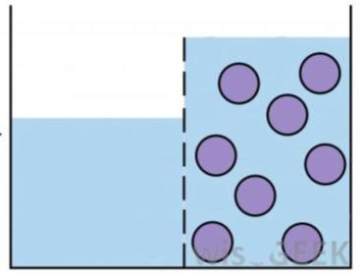
Isotonic Solutions
 When two isosmotic solutions contain solutes that can
not cross the biological membrane, they are described as isotonic with respect to that membrane.
 Tonicity is the concentration of only the solutes that
cannot cross the membrane since these solutes exert an
osmotic pressure on that membrane.

Slide 69
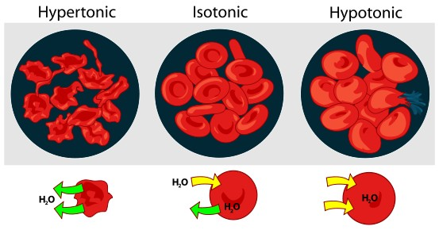
Blood cells + 0.9 % NaCl
= cells retain normal size
(Isotonic with blood)
solutions. Isotonic solutions cause no swelling or contraction. E.g. isotonic
NaCl solutions.
Blood cells + 0.2 % NaCl = cells swells and burst liberating hemoglobin or hemolysis (Hypotonic with blood)
Blood cells + 2 %
and become crenated
blood)
NaCl = cells shrink
wrinkled or
(Hypertonic with

Slide 70
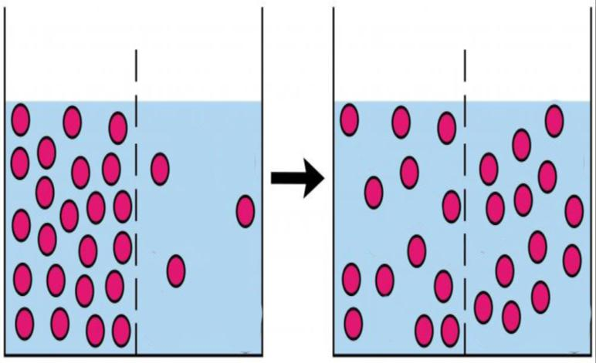
Are
all isosmotic solutions with body fluid isotonic?
 A 2.0 % boric acid solution is isosmotic to blood cell. (same osmotic pressure: 308 mosmol)
 The molecules of boric acid pass freely through the
erythrocyte membrane regardless of concentration.
 As a result, this solution act as water when it contract with
blood cells. Because it extremely hypotonic with respect to blood cause rapid hemolysis.

Slide 71
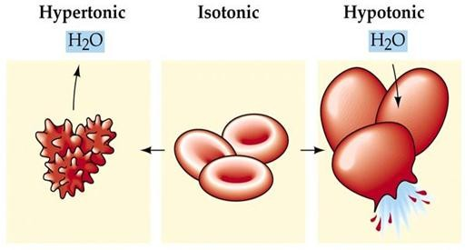
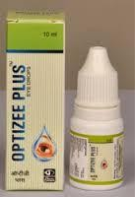
Isotonic Solutions

So the solution containing quantity of
drug calculated to be isosmotic with blood is isotonic only when blood cells are impermeable to solute molecules
and permeable to solvent molecules.

It is interesting that, Mucous lining of
the eye is true semi permeable to boric acid solutions and hence 2 % boric
acid solution is isotonic ophthalmic
preparation.

Slide 72
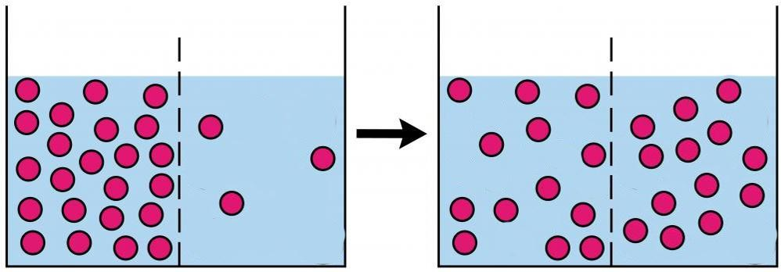
Are all isosmotic solutions
Isotonic?

Biological membranes do not always
function as perfect semipermeable membranes; some solutes pass through and some interact with the
membrane.

These solutes are regarded as solvent
and they do not exert an osmotic pressure on the membrane (the solutions are isosmotic but not isotonic)

The RBC membrane permit the
passage of water molecules, urea, ammonium chloride, alcohol, boric
acid and some drugs.

Slide 73
isotonic solution
The term Isotonic should be restricted to
solutions having equal osmotic pressures which
respect to a particular membrane (Husa)
Isotonicity value…the concentration of an
aqueous NaCl solution having the same colligative properties as solution (Goyan &
Reck)

Slide 74
Measurement
of
Tonicity

Slide 75
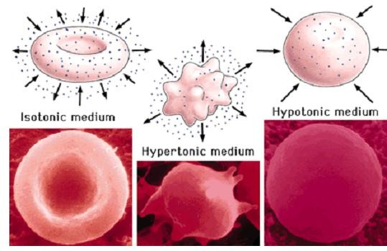

Measurement of Tonicity
1)Hemolytic Method
Suspend the RBC in solutions.
Observe the effect of various solution of drug on
appearance of RBC.
Hypotonic solutions liberate oxyhemoglobin
in
direct proportion to
hemolysed.
the
number of cells
hypertonic solution
plasmolysis
hypotonic solution
hemolysis

Slide 76
Measurement of Tonicity
2) Based on Methods used to determine
colligative properties

Slide 77
Colligative Properties of Solution
 What are Colligative properties of a solution...'why colligative'?
✓
✓
From Greek word “collected together”
Colligative properties are those properties that depend on the
concentration of the solute particles rather than the kind of solute particles.
✓
All colligative properties are related to each other by virtue of their
common dependency on the concentration of the solute molecules.

☺
☺
☺
☺
They include:
osmotic pressure
vapor pressure lowering
boiling point elevation
freezing point depression

Slide 78
Colligative Properties of Solution
2. Freezing point depression
ΔTF
= KF · b · i,
 where:
 ΔTF, the freezing-point depression, is
defined as TF (pure solvent) − TF (solution).
 KF, the cryoscopic constant, which is dependent on the properties of the solvent,
not the solute. (Note: When conducting experiments, a higher KF value makes it easier to observe larger drops in the freezing point. For water, KF = 1.853 K·kg/mol)
 b is the molality (moles solute per kilogram of solvent)
 i is the van 't Hoff factor (number of ion particles per individual molecule of solute, e.g. i = 2 for NaCl, 3 for BaCl2)..

Slide 79
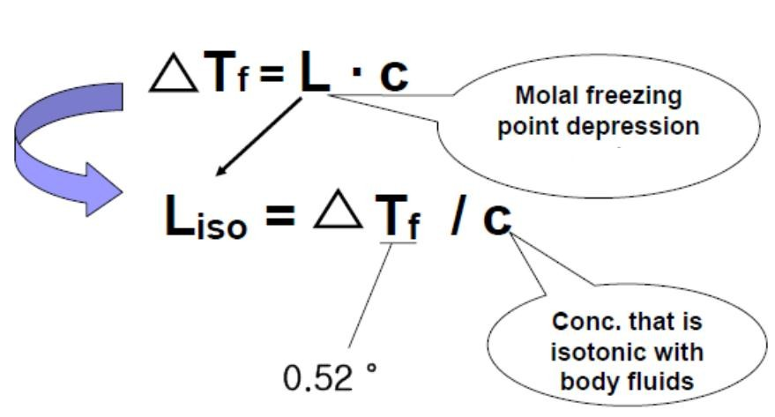
Measurement of Tonicity
3) Calculating tonicity using Liso
(Cryoscopic
Method)
 The L value can be obtained from the
freezing point lowering of solutions of
representative compounds of a given ionic type at concentration c that is isotropic with body fluids.
 The specific value of L is written as
Liso
The freezing point of blood is and of tear -0.52
C.
o
 The
Liso
value for a 0.90 % (0.154 M) solutions
of NaCl, which has freezing point depression
of 0.52 C is
 Liso = ΔT_{f}/c = 0.52/0.154 = 3.4
o

Slide 80

Measurement of Tonicity
2) Calculating tonicity using Liso (Cryoscopic Method)
Using calculating
ciso
and comparison with c, we
could determine tonicity
or we could determine freezing point depressions
our solutions and compare it with 0.52 and then determine tonicity
for

Slide 81

Example

Slide 82
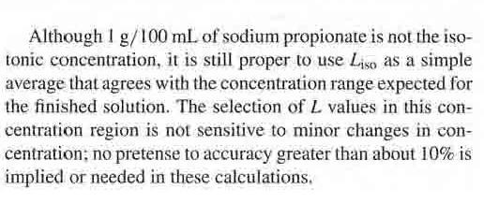

Slide 83
Methods
of
Adjusting
Tonicity

Slide 84
Methods of Adjusting Tonicity and pH


Two type
1. Class I methods : NaCl or another substance such as dextrose is added to the solution of the drug to lower the
freezing point of solution to -0.52
with body fluid.
E.g. Cryoscopic Method
ºC
and
thus make isotonic



NaCl
2. Class II amount to brought to
equivalent method
methods: water is added to the
drug in sufficient
form isotonic solution. The preparation is then
its final volume with isotonic or buffered isotonic
dilution solution.
E.g. White-Vincet method and Sprowls method


Slide 85
Methods of Adjusting Tonicity
class I Method: Cryoscopic Method
In the class I methods, sodium chloride or some
other substance is added to the solution of the drug
to lower the freezing point of the solution to −0.52 °C
and thus make it isotonic with body fluids.
The freezing point depressions ΔTf of drug solutions
can be determined experimentally or theoretically.
To determine ΔTf of drug solutions theoretically, only
the molecular weight of the drug and the
of the ionic class are required.
Liso
value

Slide 86

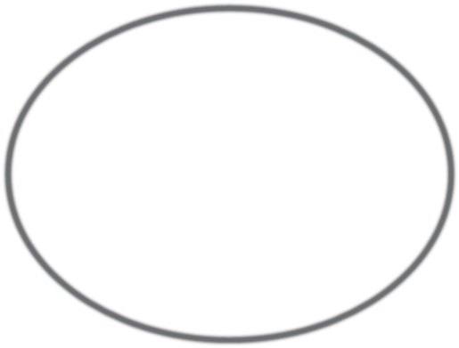
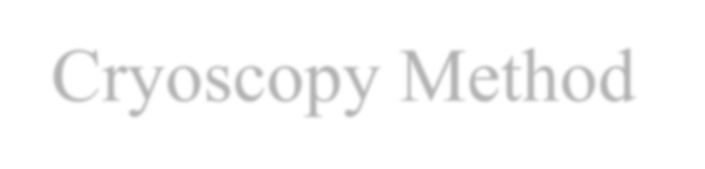







Cryoscopy Method
blood and tears = - 0.52 ˚C
ΔTf
So for any solution to be isotonic with blood, it must also have a depression of
0.52 C.
Steps:
 We find the freezing point depression caused by the given amount of the drug
We subtract it from 0.52 (T).
 For the remaining depression in
freezing point, we add sufficient sodium
chloride, knowing that 1% sodium
chloride has a freezing point lowering
of 0.58° C.

Slide 87
 For Glucose (Δt 1% solution 0.1 °C): for drugs
incompatible with Sodium chloride
that
 For Sodium chloride (Δt 1% solution 0.58 °C)
 For Magnesia sulphate (Δt 1% solution 0.08 °C)

Slide 88

Methods of Adjusting Tonicity
class I Method: Cryoscopic Method

Slide 89

Methods of Adjusting Tonicity
class
I
Method:
Cryoscopic
Method
0.76 g NaCl in 100
ml

Slide 90
Methods of Adjusting Tonicity
Class I Method: NaCl Equivalent Method
The sodium chloride equivalent(E) of a drug is the
amount of sodium chloride that has the same osmotic effect or freezing point depression of 1g of the drug
when are dissolved in 1 L water.

Slide 91



Methods of Adjusting Tonicity
Class I Method: NaCl Equivalent Method
freezing point depression
for 1 g of drug
freezing point depression for chloride
equivalent(E) of a drug

Slide 92

Methods of Adjusting Tonicity
Class I Method: NaCl Equivalent Method

Slide 93



Methods of Adjusting Tonicity
Class I Method: NaCl Equivalent Method

Slide 94


Methods of Adjusting Tonicity
Class I Method: NaCl Equivalent Method

Slide 95


Methods of Adjusting Tonicity
Class I Method: NaCl Equivalent Method

Slide 96
Methods of Adjusting Tonicity
Class II Method: White-Vincent Method
 The class II methods of computing tonicity involve the addition
of water to the drugs to make an isotonic solution, followed by
the addition of an isotonic buffered diluting
solution to the final volume.
vehicle
to
bring
the
 White-Vincent method(Example)
 GOAL: make 30mL of a 1% solution of procaine HCl
isotonic with body fluid
 E=0.21
Thus 1% solution of procaine HCl is hypotonic

Slide 97

Methods of Adjusting Tonicity
Class II Method: White-Vincent Method
 Steps for White-Vincent method
 ①Weight in grams of drug(0.3 g) •Sodium Chloride equivalent
E(0.21) = quantity of sodium
drug(0.063 g)
Chloride
equivalent
to
w
of
 ②0.9 g/100mL = 0.063 g / V
 ③V = 0.063 •100/0.9
 ④V = 7.0 mL
 ⑤Add isotonic-buffered diluting solution to complete

Slide 98

Methods of Adjusting Tonicity
Class II Method: White-Vincent Method

Slide 99



Slide 100

Methods
of Adjusting
Tonicity
Class II Method: Sprowls Method
Sprowls method is a simplification of White-Vincent Method in which V values for drugs of fixed weights (0.3 g in 1% solution) are computed and constructed as a table.

Slide 101



Slide 102


Slide 103



Slide 104


Slide 105


Slide 106







THANK
YOU
FOR
ATTENTION

