Slide 1
Drug Dosage Based on Body Surface Area

Slide 2
The body surface area (BSA) method of calculating drug doses is widely used for two types of patient groups:
cancer patients receiving chemotherapy and
pediatric patients, with the general exception of neonates, who are usually dosed on a weight basis with consideration of age and a variety of biochemical, physiologic, functional, pathologic, and immunologic factors.
A useful equation for the calculation of dose based on BSA is:

Slide 3


Slide 4
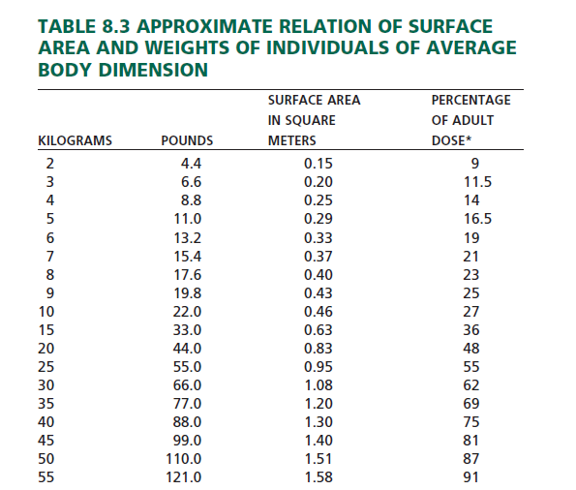

Slide 5
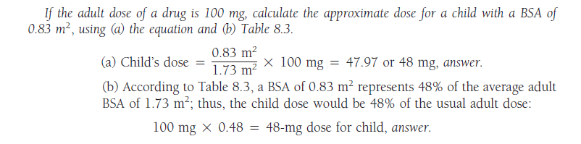

Slide 6
Nomograms
Most BSA calculations use a standard nomogram, which includes both weight and height.
Nomograms for children and adults are shown in the following tables.
The BSA of an individual is determined by drawing a straight line connecting the person’s height and weight.
The point at which the line intersects the center column indicates the person’s BSA in square meters.

Slide 7
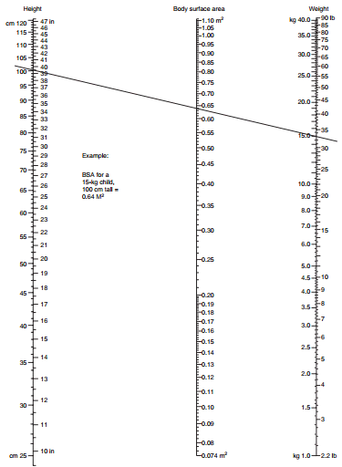
Nomogram for Determination of Body Surface Area from Height and Weight

