Slide 1
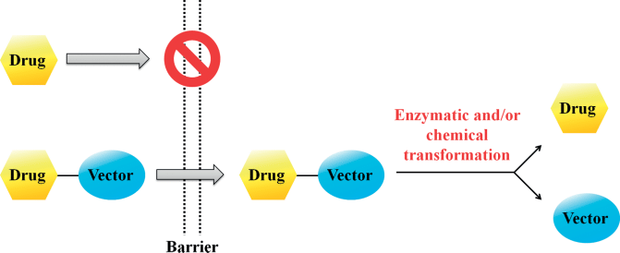
Organic Pharmaceutical Chemistry IV
Lec1: Basic concept of prodrugs
TAMMAR HUSSEIN ALI

Slide 2
Module objectives:
give the students knowledge and experience in
1.
To
prodrugs and hormones as part of their medicinal
and pharmaceutical field.
2.
It
includes
classification,
synthesis,
biotransformation
drugs to improve some side effect.
and/or
formulation
of
certain
their action as well as to avoid
➢
Why to study Organic
Pharmaceutical Chemistry?

Slide 3
About this module: Topics to be covered.
1.
"Basic
concept
of prodrugs;
Covalent bonds
(cleavable); Prodrugs of functional groups; Types
of prodrugs."
2.
"Chemical
delivery
systems;
Polymeric
prodrugs;
Types and structure of polymers; Cross-linking
reagents."
"Drug targeting." "Project."
3.
4.
5.
"Combinatorial
chemistry;
Peptides and
other
linear structures; Drug like molecules; Support and linker; Solution-phase combinatorial chemistry."
6.
"Detection,
purification
and
analgesics;
Encoding
combinatorial
libraries;
High-throughput
screening; Virtual screening;
and library design."
Chemical diversity

Slide 4
Basic concept of prodrugs:
•
The term prodrug was introduced by Albert
who
used
“prodrug”
or “proagent”
to
refer
to
a
pharmacologically
inactive
compound
that
is transformed by
the
mammalian
system
into
an
active
substance
by
either
chemical or metabolic means.

Slide 5
Basic concept
of prodrugs:
•
Another
term
drug
latentiation,
which
implies
a
time
lag
element
or
component,
was
coined
by
Harper.

Slide 6
Basic concept of prodrugs:
•
Later,
the
concept
of
prodrug
and
latentiated
drug
for
solving
various
problems was attempted and the definition
of drug latentiation was extended to
include
parent
non–enzymatic
compounds.
regeneration
of

Slide 7
Basic concept of prodrugs:
•
The prodrug approach has emerged
as
to
a tool
drug
in
overcoming various
obstacles
such as:
formulation and targeting
1.
2.
3.
4.
5.
6.
Chemical instability.
Poor aqueous solubility.
Inadequate brain penetration.
Insufficient oral absorption.
Local irritation.
Toxicity.

Slide 8
Basic concept of prodrugs:
•
It
is
justified
by the
fact that
once
the
has can
barrier to the use of parent compound
been overcome, these temporary forms
be
converted
to
its
the
free
parent
compound
that can exert
pharmacological activity.

Slide 9
Definition
•
A
prodrug
is
thus
defined
as
a
biologically
inactive
derivative
of
a
parent
drug
molecule
that usually requires a chemical or enzymatic
transformation (activation) within the body to release the active drug, and possess improved delivery properties over the parent molecule.

Slide 10
Definition
•
These attractive features render the prodrugs a well-
recognized strategy to improve drug targeting.
•
The
drug
targeting
improvement
is
employed
to
or
enhance
the
physicochemical, biopharmaceutical
pharmacokinetic
properties
of
pharmacologically
potent
compounds,
and
thereby
increase
the
usefulness of a potential drug.

Slide 11
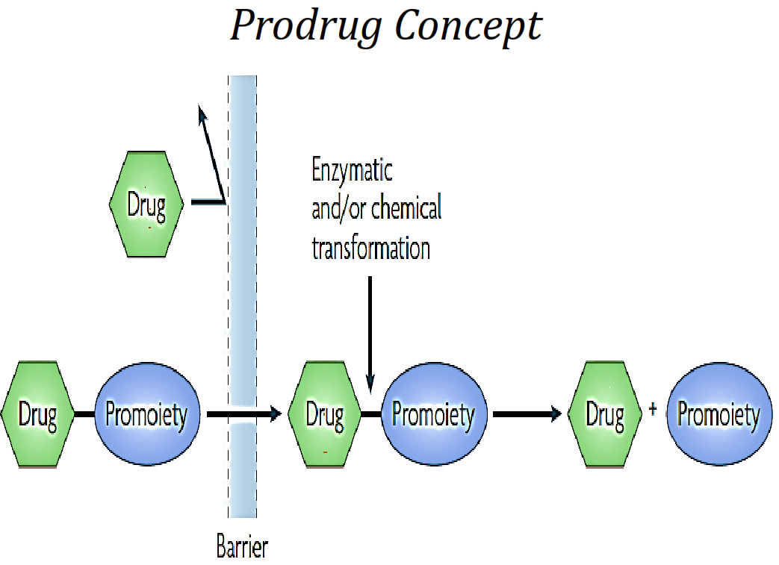
Prodrug Concept

Slide 12
H.W
1
What is
and the
the difference between
“codrug”?
“prodrug”
Explain
briefly
and
give
an
example
on
each.
30-Sep-17
13

Slide 13
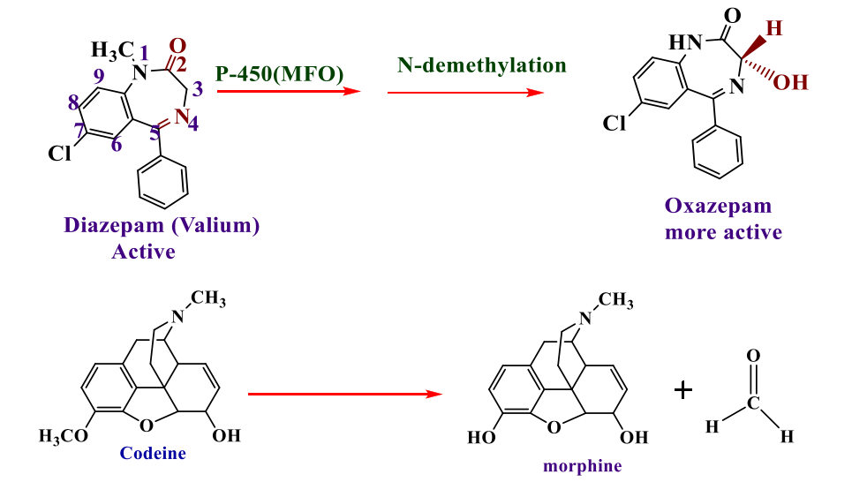
Example:-

Slide 14
These two situations were distinguished by Harper, who in 1959 introduces the term
drug latentiation (included later).
Drug latentiation(Harper):- The process of purposely designing and synthesizing a
molecule that specifically requires bioactivation to a pharmacologically active substance.

Slide 15
Non-prodrugs
It is also important to distinguish prodrugs from soft and hard drugs.
Hard drugs:- are compounds that are designed to contain the structural
characteristics necessary for pharmacological activity but in a form that is not
susceptible to metabolic or chemical transformation.
1-
2-
3-
Increased efficiency by avoiding metabolism.
No toxic metabolites are formed.
HOWEVER, less readily eliminated due to lack of
metabolism.
.

Slide 16
Soft drugs: - ‘‘biologically active compounds (drugs)
characterized by a predictable and fast
in vivo metabolism to inactive and non-toxic moieties, after they
have achieved their therapeutic role’’(such as short acting β-
blocker agent, esmolol),Thus soft drugs are considered to be the
opposite of prodrugs.

Slide 17
Soft drugs: -

Slide 18
There are two mechanism for the conversion of prodrug
to an active drug:-

Slide 19
Covalent
bonds
(cleavable):
•
Olsalazine
palmitate
and
chloramphenicol
are
examples
of
prodrugs
that are cleaved to
smaller compounds,
one
of
which
is
the
active
drug.
30-Sep-17
14

Slide 20
Covalent
bonds
(cleavable):
30-Sep-17
15

Slide 21
Covalent bonds
(cleavable):
•
Others
are metabolic
precursors
that
is
converted to the active form.
•
An
example of
this
type
of
prodrug
is
is
menadione, a simple naphthoquinone that
converted
(vitamin K)
in
the
liver
to
phytonadione
30-Sep-17
16

Slide 22
Metabolic
precursors
30-Sep-17
17

Slide 23
Prodrugs of functional groups:
•
Occasionally,
the prodrug
approach
is
a
used
drug
to
enhance
the
absorption
of
that
is
poorly
absorbed
from
the
gastrointestinal tract.
30-Sep-17
18

Slide 24
Prodrugs of
functional groups:
•
Enalapril
is
the
ethyl
ester
of
enalaprilic
acid,
an
active
inhibitor of
angiotensin-
converting enzyme (ACE).
•
The
ester
prodrug
is
much
more
readily
the
absorbed
orally
than
pharmacologically active
30-Sep-17
carboxylic
acid.
19

Slide 25
Prodrugs
of
functional
groups:
30-Sep-17
20

Slide 26
Bio
reversible derivatives for various
groups
functional
–
Various types of functional groups
in different therapeutic agents.
are present
– These
functional
groups
react
with
other
functional
groups
of
nontoxic
promoiety
to
form prodrugs.
30-Sep-17
21

Slide 27
Types of prodrugs:
•
Various
prodrugs
for
compounds
containing different
listed below:
functional
groups
are
1.
2.
Esters.
Prodrug for Amides, Compounds.
Imides and Other
Acidic
3.
4.
Prodrugs
Prodrugs
for Amines, and.
with Carbonyl Groups.
30-Sep-17
22

Slide 28
•
Esters:
•
Amides:
•
Imides:
•
Amines:
30-Sep-17
23

Slide 29
Advantage s of prodrug
1) Overcome drug problems such as
A)
B)
Alleviation pain at the site of injection.
Elimination of unpleasant taste, this is so important for children, when we not have
more or other choices.
Decrease metabolic inactivation.
Increase chemical stability.
Prolong or decrease the duration of action. according to the need, mostly the main
purpose that is need is prolong the duration of action. Specially for drug for chronic
use (specially multiple and long use) such as antibiotic.
Decrease toxicity of drug.
Increase absorption of drug.
Poor site specificity: - Site- directed delivery system (drug targeting) to get effective
concentration in a certain tissue. Targeting of drug mean the controlling on its
distribution, this lead to decrease the coast ,get large concentration in certain organ,
better effect, less S/E, this is so important specially in case of anticancer drug to
decrease toxicity.
To overcome cost and time problems. (And this is the advantage of prodrug over
drug derivatives).
C)
D) E)
F)
G)
H)
2)

Slide 30
So for such drug, the problem is detected
prodrug is design.
and
depends
on
it
the
Properties of ideal prodrug
1-
2-
Pharmacological Inertness
Rapid transformation, chemically
or enzymatically,
into the active form at the target site
Non-toxic metabolic fragments followed by their rapid elimination
3-

Slide 31
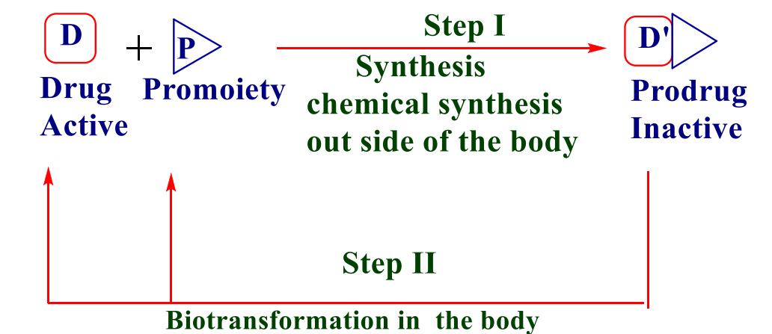
Types of prodrugs
There are four major classes of prodrugs, namely:-
1) Carrier –linked prodrugs: A compound that contains an active drug linked to a carrier group (also known as a promoiety), that is removed enzymatically.

Slide 32
1)
Bioprecursor prodrugs: which do not contain a promoiety
rather contain a latent functionality that is metabolically or chemically transformed to the active drug molecule.
but
1)
Macromolecular prodrugs: where the carrier is a
macromolecule such as a PEG(polyethyleneglycol).
1)
Drug-antibody conjugates: where the carrier is an antibody
raised against tumor cells.
Carrier –linked prodrugs:- Drug is linked to promoiety and bond
must be covalent bond and must be liable in vivo to hydrolysis by
either enzyme or change in the pH.

Slide 33
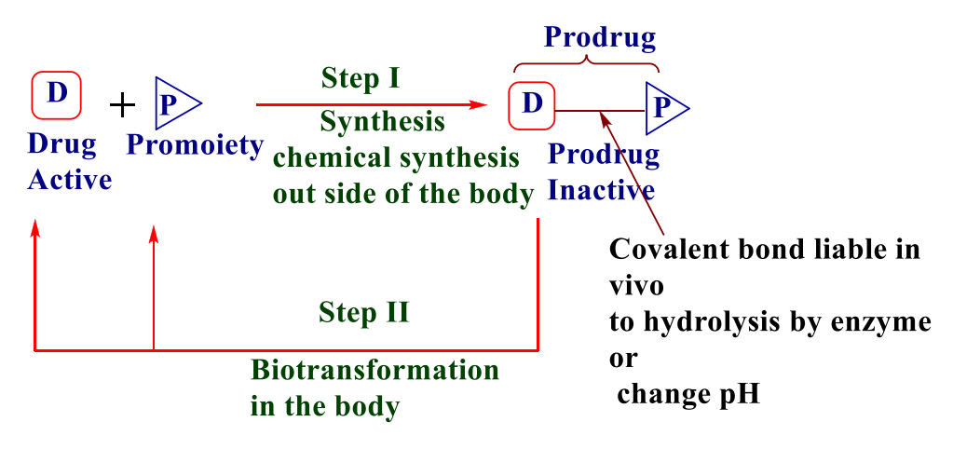

Slide 34
The promoiety who is not necessary for activity but may impart
some desirable property to the drug such as increase lipid or
water solubility or site directed delivery.
The promoiety could be small or polymer (so called polymeric prodrug), that mean the carrier either small or large to give the purpose. Small molecule may be amino acid (single) which is L- type or simple aliphatic acid such as succinic acid or aromatic acid such as benzoic acid. The amino acid or acid could be used to increases the hydrophilicity and water solubility. While branched aliphatic, long chain or aromatic acid could used to increases the hydrophobicity.
The polymer mainly uses which is either natural or synthetic, the natural polymer such as carbohydrate (Dextran), protein or poly peptide or poly amino acid, while there is limited synthetic polymer use for medical use.

Slide 35
Criteria of promoiety :-
1)
Should contain functional
with the drug.
Must solve drug problem
Must be safe Not toxic Biodegradable Excretable
Not accumulate(moderate
group
that
can
interact
chemically
2)
3)
4)
5)
6)
7)
MW)

Slide 36
Carrier linked prodrug can be further subdivided into:-
1- Bipartate:- composed of one carrier (group) attached to the drug.

Slide 37
2- Tripartate:- carrier group is attached via linker to drug.•

Slide 38
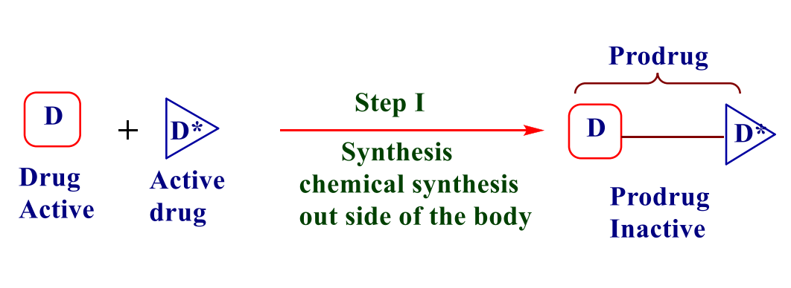
3- Mutual prodrug:- two drugs linked together.•

Slide 39
Chemical classification of carrier linked prodrug
The chemical nature of carrier linked prodrugs that can be
prepared depend on the two factors:-
1) Chemical nature of the original drug (type of functional group)
2) Type of a problem in the original drug to be solved.
The carrier linked prodrugs are classified according to the
chemical structure or nature of the prodrug.

Slide 40
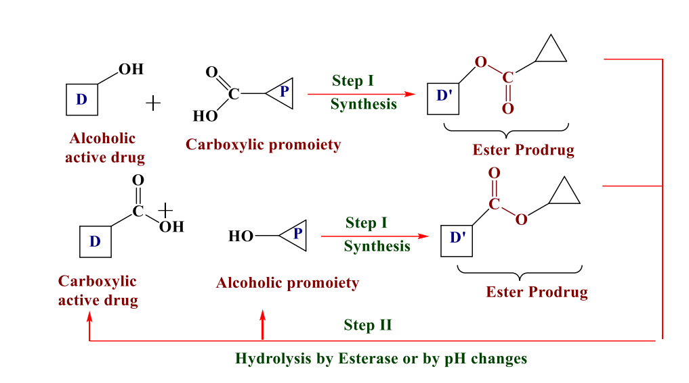
Ester pro drug.•
If the molecule contains either an alcohol or carboxylic acid
functionality an ester prodrug may be easily synthesized.

Slide 41
The ester prodrug is the most common type of prodrug
because:-
1.
2.
The ease of formation the ester prodrug.
The ester prodrug can be hydrolyzed easily to give the active
drug.
Hydrolysis is take place by esterase enzyme.
Esterase enzyme present in must tissue that are capable of
hydrolyzing a wide variety of ester linkages.
Chemical hydrolysis of the ester function may also occur to
some extent.
3.
4.
5.

Slide 42
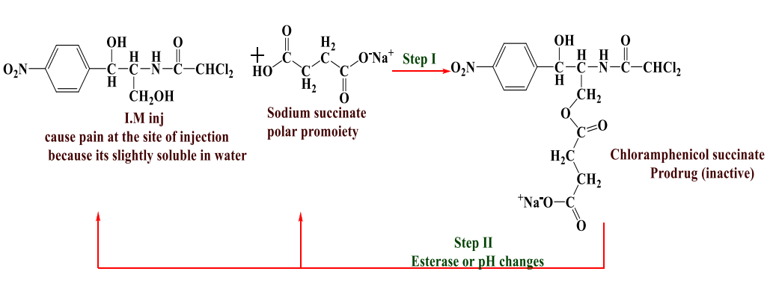
Examples:-
Chloramphenicol(antibiotic)
Chloramphenicol when given
parentrally by IM inj. it is painful
,since it ppt. at site of injection because of its low water solubility,
so when polar functional group like succinate was added lead to increase water solubility and reduce pain.

Slide 43
