Slide 1
States of matter
Physical pharmacy
Noor Alsaadi

Slide 2
the properties related to single particle of matter, such as atomic size, ionization enthalpy, electronic charge density, molecular shape and polarity, etc. Most of the observable characteristics of chemical systems with which we are familiar represent bulk properties of matter,

Slide 3
the properties associated with a collection of a large number of atoms, ions or molecules. For example, an individual molecule of a liquid does not boil but the bulk boils.

Slide 5
Collection of water molecules have wetting properties; individual molecules do not wet. Water can exist as ice, which is a solid; it can exist as liquid; or it can exist in the gaseous state as water vapour or steam. Physical properties of ice, water and steam are very different.

Slide 6
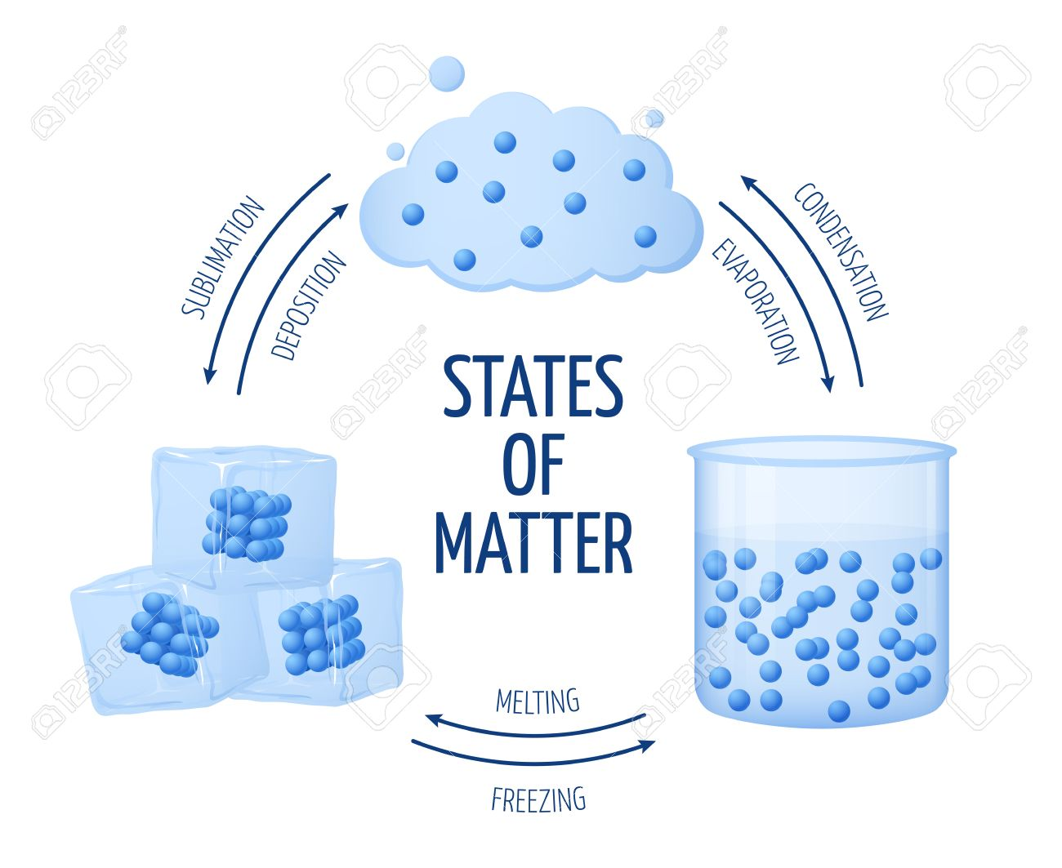

Slide 7
In all the three states of water chemical composition of water remains the same i.e., H2O. Characteristics of the three states of water depend on the energies of molecules and on the manner in which water molecules aggregate. Same is true for other substances also.

Slide 8
Knowledge of these forces and their balance (equilibrium) is important for understanding not only the properties of gases, liquids, and solids, but also interfacial phenomena, flocculation in suspensions, stabilization of emulsions, compaction of powders in capsules, dispersion of powders or liquid droplets in aerosols, and the compression of granules to form tablets.

Slide 9
INTERMOLECULAR FORCES Intermolecular forces are the forces of attraction and repulsion between interacting particles (atoms and molecules). This term does not include the electrostatic forces that exist between the two oppositely charged ions and the forces that hold atoms of a molecule together i.e., covalent bonds.

Slide 11
Attractive intermolecular forces are known as van der Waals forces, van der Waals forces vary considerably in magnitude and include dispersion forces or London forces, dipole-dipole forces, and dipole-induced dipole forces. A particularly strong type of dipole-dipole interaction is hydrogen bonding.

Slide 12
Only a few elements can participate in hydrogen bond formation, therefore it is treated as a separate category.
At this point, it is important to note that attractive forces between an ion and a dipole are known as ion-dipole forces and these are not van der Waals forces. We will now learn about different types of van der Waals forces.

Slide 13
Dispersion Forces or London Forces Atoms and nonpolar molecules are electrically symmetrical and have no dipole moment because their electronic charge cloud is symmetrically distributed.

Slide 14
But a dipole may develop momentarily even in such atoms and molecules. This can be understood as follows. Suppose we have two atoms ‘A’ and ‘B’ in the close vicinity of each other

Slide 15
so happen that momentarily electronic charge distribution in one of the atoms, say ‘A’, becomes unsymmetrical i.e., the charge cloud is more on one side than the other.

Slide 16
This results in the development of instantaneous dipole on the atom ‘A’ for a very short time. This instantaneous or transient dipole distorts the electron density of the other atom ‘B’, which is close to it and as a consequence a dipole is induced in the atom ‘B’.

Slide 17
The temporary dipoles of atom ‘A’ and ‘B’ attract each other. Similarly temporary dipoles are induced in molecules also. This force of attraction between two temporary dipoles is known as London force.

Slide 18
Another name for this force is dispersion force. These forces are always attractive and interaction energy is inversely proportional to the sixth power of the distance between two interacting particles (i.e., 1/(r)6 where r is the distance between two particles).

Slide 19
These forces are important only at short distances (~500 pm) and their magnitude depends on the polarisability of the particle.

Slide 20
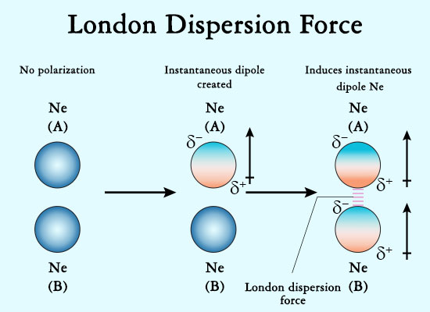

Slide 21
Dipole -Dipole Forces : Dipole-dipole forces act between the molecules possessing permanent dipole. Ends of the dipoles possess “partial charges” and these charges are shown by Greek letter delta (δ). Partial charges are always less than the unit electronic charge (1.6×10–19 C).

Slide 22
The polar molecules interact with neighboring molecules, the next slide electron cloud distribution in the dipole of hydrogen chloride and shows dipole-dipole interaction between two HCl molecules. This interaction is stronger than the London forces but is weaker than ion-ion interaction because only partial charges are involved.

Slide 24
The attractive force decreases with the increase of distance between the dipoles. As in the above case here also, the interaction energy is inversely proportional to distance between polar molecules.

Slide 25
Dipole-dipole interaction energy between stationary polar molecules (as in solids) is proportional to 1/(r)3 and that between rotating polar molecules is proportional to 1/(r )6 where r is the distance between polar molecules.

Slide 26
Dipole-Induced Dipole Forces :
This type of attractive forces operate between the polar molecules having permanent dipole and the molecules lacking permanent dipole. Permanent dipole of the polar molecule induces dipole on the electrically neutral molecule by deforming its electronic cloud

Slide 27
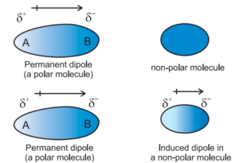

Slide 28
an induced dipole is developed in the other molecule. In this case also interaction energy is proportional to 1/(r)6 where r is the distance between two molecules. Induced dipole moment depends upon the dipole moment present in the permanent dipole and the polarisability of the electrically neutral molecule.

Slide 29
H- bonding :
It is found in the molecules in which highly polar N–H, O–H or H–F bonds are present. Although hydrogen bonding is regarded as being limited to N, O and F; but species such as Cl may also participate in hydrogen bonding.

Slide 30
Intermolecular forces discussed so far are all attractive. Molecules also exert repulsive forces on one another. When two molecules are brought into close contact with each other, the repulsion between the electron clouds and that between the nuclei of two molecules comes into play.

Slide 31
Magnitude of the repulsion rises very rapidly as the distance separating the molecules decreases. This is the reason that liquids and solids are hard to compress.
In these states molecules are already in close contact; therefore they resist further compression; as that would result in the increase of repulsive interactions.

Slide 32
