Slide 1
Ratio

Slide 2
The relative magnitude of two quantities is called their ratio.
Since a ratio relates the relative value of two numbers, it resembles a common fraction except in the way in which it is presented.
Whereas a fraction is presented as, for example, 1⁄2, a ratio is presented as 1:2 and is not read as ‘‘one half,’’ but rather as ‘‘one is to two.’’
All the rules governing common fractions equally apply to a ratio. Of particular importance is the principle that if the two terms of a ratio are multiplied or are divided by the same number, the value is unchanged, the value being the quotient of the first term divided by the second.
For example, the ratio 20:4 or 20⁄4 has a value of 5; if both terms are divided by 2, the ratio becomes 10:2 or 10⁄2, again the value of 5.

Slide 3
When two ratios have the same value, they are equivalent.
An interesting fact about equivalent ratios is that the product of the numerator of the one and the denominator of the other always equals the product of the denominator of the one and the numerator of the other; that is, the cross products are equal:

Slide 5
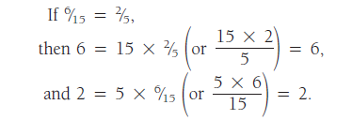
We discover further that the numerator of the one fraction equals the product of its denominator and the other fraction

Slide 6
And the denominator of the one equals the quotient of its numerator divided by the other fraction:

Slide 7
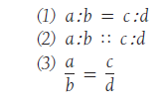
An extremely useful practical application of these facts is found in PROPORTION
A proportion is the expression of the equality of two ratios. It may be written in any one of three standard forms:

Slide 8
Each of these expressions is read: a is to b as c is to d, and a and d are called the extremes (meaning ‘‘outer members’’) and b and c the means (‘‘middle members’’).

Slide 9
Example:
If 3 tablets contain 975 milligrams of aspirin, how many milligrams should be contained in 12 tablets?
If 3 tablets contain 975 milligrams of aspirin, how many tablets should contain 3900 milligrams?

