Slide 1



Epidemiology of Infectious Diseases

Slide 2
Purposes of Public Health
Surveillance
1. Assess public health status
2.
3.
4.
Define public health priorities
Evaluate programs
Stimulate research

Slide 3
Measures of Disease Frequency
Prevalence and incidence
are commonly confused.
They are similar,
but differ in the number of cases included in the numerator:
•Prevalence includes all cases
（new and old）during a given time
period.
•Incidence includes only the number of
new
a given time period

Slide 4
Prevalence
Prevalence = number of existing case
subdivided by total population
The numerator for prevalence includes all persons during a specified interval or point in time, regardless of when the condition began.For example, a visual
examination survey of 2477 persons between the ages of 52 and 85 years showed that 310 had cataracts. The prevalence of the condition was310 / 2477 x 100 = 12.5

Slide 5


Concepts Specific to Infectious
Epidemiology
Disease
Attack rate, immunity, vector,
transmission, carrier, subclinical
disease, serial interval,
source,
exposure, reservoir, incubation
period, colonization, generations, susceptible, non-specific immunity, clone, resistance, repeat episodes …

Slide 6
What is infectious disease epidemiology?
A
case is a risk factor …
Infection
in
one
person
can
be
transmitted
to
others

Slide 7
What is infectious disease epidemiology?
What is infectious disease epidemiology used for?
Identification of causes of new, emerging infections, e.g.
SARS
Surveillence of infectious disease
Identification of source of outbreaks
HIV,
Studies of routes of transmission and
infections
Identification of new interventions
natural history of
(

Slide 8

Routes
Direct
❖ Skin-skin
of
transmission
Indirect
❖ Food-borne
❖ Salmonella
❖ Water-borne
❖ Hepatitis A
❖ Vector-borne
❖ Malaria
❖ Air-borne
❖ Chickenpox
❖ Herpes
type 1
❖ Mucous-mucous
❖ STD
❖ Across placenta
❖ toxoplasmosis
❖
Through breast milk
❖ HIV
Sneeze-cough
❖ Influenza
❖
Exposure
❖ A relevant contact
– depends on the agent
Skin, sexually, water contact, etc
(

Slide 9
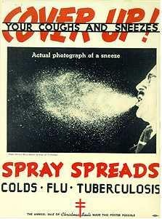
(

Slide 10

Exposure
to
Infectious
Agents
No infection
Clinical
Sub-clinical
Carrier
Death
Carrier
Immunity
No
immunity
Outcome

Slide 11
Transmission
Cases
❖
❖
❖
❖
Index – the first case identified
Primary – the case that brings the infection
Secondary – infected by a primary case
into
a population
Tertiary – infected
by
a
secondary
case
T
S
Susceptible
P
S
Immune
S
T
Sub-clinical
Clinical

Slide 12
Person-to-Person Transmission
Data from Dr. Simpson’s studies in England (1952)
Measles
Chickenpox
Rubella
Children exposed
Children ill
251
201
238
172
218
82
attack
rate
0.80
0.72
0.38
Attack rate =
ill
exposed

Slide 13

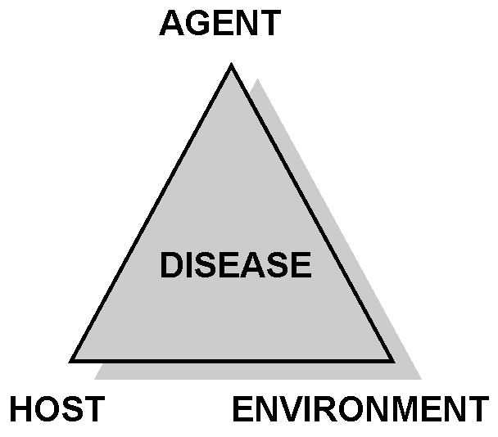
Epidemiologic
Triad
Disease is the result of
forces within a dynamic
system consisting of:
agent of infection
host
environment

Slide 14
Factors Influencing Disease
Transmission
Agent
• Infectivity
• Pathogenicity
• Virulence
• Immunogenicity
Environment
• Weather
• Housing
• Geography
• Occupational setting
• Air quality
• Food
• Antigenic
• Survival
stability
• Age
• Sex
• Genotype
• Behaviour
• Nutritional
Host
status
• Health status

Slide 15
Epidemiologic Triad-Related Concepts
Infectivity (ability to infect)
(number infected / number susceptible) x 100
Pathogenicity (ability to cause disease)
(number with clinical disease / number infected) x 100
Virulence (ability to cause death)
(number of deaths / number with disease) x 100
All are dependent on host factors

Slide 16
Predisposition to Infections
(Host Factors)
Gender
Genetics Climate and
Weather Nutrition,
Stress, Sleep Smoking
Stomach Acidity
Hygiene

Slide 17
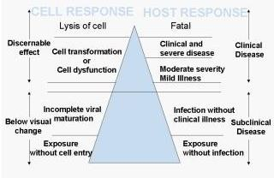
Iceberg Concept of Infection

Slide 18
Infectious Agents
Bacteria
Viruses
Fungi
Protozoa
Helminths
Algae
Prions
(proteinaceous infectious agents)

Slide 19
Reservoirs
A host that carries a pathogen without injury to itself and serves as a source of infection for other host organisms
(asymptomatic infective carriers)

Slide 20
Reservoirs
Humans
{hepatitis}
Other Vertebrates
{zoonoses}
Birds & Bats
{histoplasmosis}
NOT vectors

Slide 21
Vectors
A host that carries a pathogen without injury to itself and spreads the pathogen to susceptible organisms
(asymptomatic carriers of pathogens)

Slide 22
Arthropod Vectors
Pathogen - Vector
Viruses (Arbovirus) - Mosquitoes
Bacteria (Yersinia) - Fleas
Bacteria (Borrelia) - Ticks
Rickettsias (R. prowazeki) - Lice, ticks
Protozoa (Plasmodium) - Mosquitoes
Protozoa (Trypanosoma) -Tsetse flies
Helminths (Onchocerca) - Simulium flies

Slide 23

Koch’s Postulates
The same organism is present in every case
It is isolated or grown in pure culture
The disease can be reproduced in healthy animals after infection with pure culture
The identical pathogen is reisolated from the experimental animals

Slide 24
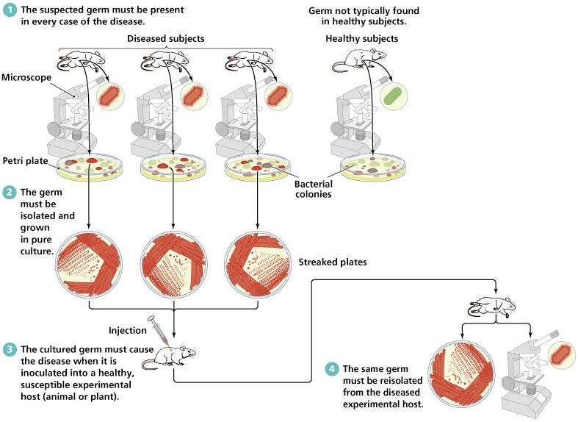
Koch’s Postulates

Slide 25
Endemic -
Epidemic
-
Pandemic
R > 1
R = 1
R < 1
Time
❖ Endemic
❖ Transmission
constant
❖ Epidemic
occur, but the number of
cases remains
❖ The number of cases increases
❖ Pandemic
❖ When epidemics occur at several continents – global
epidemic

Slide 26
Endemic
vs
Epidemic
Number of Cases of a Disease
Endemic
Epidemic
Time

Slide 27
Levels of Disease Occurrence
Sporadic level: occasional cases occurring at
irregular intervals
Endemic level: persistent occurrence with a low
moderate level
Hyperendemic level: persistently high level of occurrence
Epidemic or outbreak: occurrence clearly in
to
excess of the expected level for a given time period
Pandemic: epidemic spread over several countries or continents, affecting a large number of people

