Slide 1
Diarrhea in Adults
• Acute diarrhea is one of the most common
medical complaints in any population.
• In all patients with acute diarrhea the attention to fluid
and salt intake is important.

Slide 2
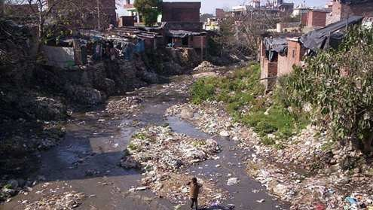

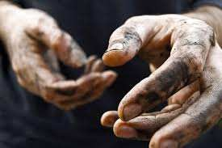
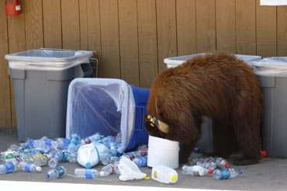
Most GIT infections
by food and water
Fecal-oral cycle can be broken by:
-Proper sewage disposal
are transmitted
contamination
-Disinfection of
drinking water
-Proper food preparation
and storage
unhygienic living conditions

Slide 3
Definitions and Syndromes in
Infectious Diarrhea
Acute diarrhea can be defined as a new onset of
•
three
or more
than
3
unformed
stools
during
a
24-hour time period.
The duration of an acute diarrhea is always less
•
than
14
days.
with
Acute
diarrhea
is
frequently
symptoms abdominal
associated
one
or
more
enteric
like nausea,
vomiting,
increase
in
gas, abdominal pain or
cramps, tenesmus, fecal
urgency,
or
passage
of
stools
containing
gross
blood and mucus.

Slide 4
Acute Diarrhea
Diarrhea of < 2 weeks duration is most commonly or noninvasive pathogens and their enterotoxins.
caused
by
invasive
Acute noninflamatory diarrhea
• Watery, non-bloody (stool)
• Usually mild, self-limited
• Caused by virus or noninvasive bacteria
• Diagnostic evaluation is limited
Acute inflamatory diarrhea
• Blood or pus, (stool)
• Usually caused by an invasive or toxin producing bacterium
• Diagnostic evaluation requires routine stool bacterial culture.

Slide 5
Acute non-inflamatory diarrhea
• In temperate climate acute non-inflammatory
diarrhea
in
adults
or
may
more
be
caused
by
by
Rotaviruses,
Noroviruses,
commonly
Astroviruses.
Caliciviruses,
• Several
agents
of
food
poisoning,
such
as
Clostridium
perfringens, Bacillus
cereus,
and
Staphylococcus
aureus,
also
commonly
syndromes
cause
non-inflammatory
diarrheal
in adults.

Slide 6
Food Poisoning
Contaminant
Onset of symptoms
Foods affected and means of transmission
Campylobacter
2 to 5 days
Meat and poultry. Contamination occurs
during processing if animal feces contact meat surfaces.
Clostridium botulinum
12 to 72 hours
Home-canned foods
Clostridium perfringens
8 to 16 hours
Meats, stews and gravies.
Escherichia coli
(E.
1 to 8 days
Beef contaminated with feces during
slaughter.
coli) O157:H7
Salmonella
1 to 3 days
Raw or contaminated meat, poultry, milk
or egg yolks. infected food handler.
Shigella
24 to 48 hours
Seafood and raw, ready-to-eat produce.
food handler.
Bacillus cereus
1 to 6 hours
reheated fried rice
Staphylococcus
aureus
1 to 6 hours
Meats and prepared salads, cream sauces,
and cream-filled pastries. Can be spread by hand contact, coughing and sneezing.
Vibrio vulnificus
1 to 7 days
Raw oysters and raw or undercooked mussels, clams, and whole scallops. Can be spread through contaminated seawater.

Slide 7
Food Poisoning
• Symptoms can develop rapidly, within 30
minutes, or slowly, worsening over days to weeks.
• Most of the common contaminants can cause:
nausea, vomiting, diarrhea, and
cramping.
abdominal
• Usually food poisoning is not serious and the
illness runs its course within 24-48 hours.

Slide 8
Food Poisoning
Treatment
2. Prevent Dehydration
1.
Control
Nausea
and
Vomiting
•
Avoid solid foods
until
•
Drink
starting
clear
with
fluids,
small
vomiting
ends.
Then
eat
light, bland foods, such as
sips
and
gradually
saltine crackers,
rice, or bread.
bananas,
drinking more.
•
If
vomiting
and
more drink
•
Sipping
liquids
may
diarrhea
than 24
last
hours,
help avoid vomiting.
Don’t eat fried, greasy, spicy, or sweet foods.
•
an
oral
rehydration
solution.

Slide 9
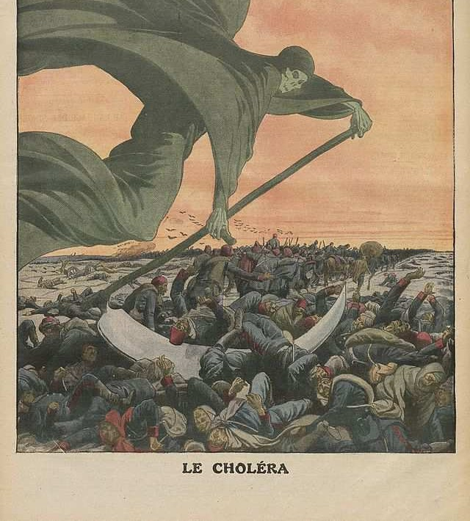

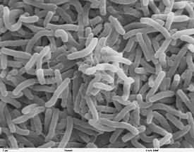
Cholera
Vibrio cholerae serotypes that produce cholera toxin.
Often, people get cholera from eating fish that is not cooked enough (contaminated water ).
•
•
•
The toxin causes diarrheal disease.
Secretory diarrhea may
torrential outpouring of the intestine with a risk
result in
fluid into of
subsequent hypovolaemic shock
and renal failure and death.

Slide 10
Cholera
Cholera is an infection of the intestine by the bacterium Vibrio cholerae.
•
•
Symptoms: may range from none, to mild, to
severe.The
classic symptom is large amounts
of
watery diarrhea that lasts a few days. Vomiting and muscle cramps may also occur. Diarrhea can be so
severe that it leads within hours to severe dehydration and electrolyte imbalance.This may result in sunken
eyes, cold skin, decreased skin elasticity, and wrinkling of the hands and feet. The dehydration may result in the skin turning bluish. Symptoms start two hours to five days after exposure.
Cholera affects an estimated 3–5 million people worldwide and causes 58,000–130,000 deaths a year as of 2010
•

Slide 11

Typical "rice water" diarrhea

Slide 12
Treatment
Oral rehydration therapy (ORT)
•
•
•
Intravenous rehydration may be necessary.
Ringer's lactate is the preferred solution, often with
added potassium
Antibiotics (Testing for resistance ):
•
•
Doxycycline,
cotrimoxazole,
erythromycin,
tetracycline, chloramphenicol,
•
Vaccine: Preventive inoculation against cholera in
1966
A number of safe and effective oral vaccines for cholera are available.
•

Slide 13
Escherichia coli
traveler's diarrhea
• Travelers' diarrhea (TD) is the most
common
between
illness
affecting
travelers.
Each
year
20%-50% of international travelers, an estimated
10 million persons, develop diarrhea.
• The primary source of infection is ingestion of
fecally contaminated food or water.
• Enterohemorrhagic
produce Shiga toxin
strains
such
as
E.
coli

Slide 14
What treatments are effective for
travelers' diarrhea?
•
TD usually is a self-limited disorder and often resolves without specific treatment.
Clear liquids are routinely recommended for adults. (ORT) Travelers who develop three or more loose stools in an 8-hour
period---especially if associated with nausea, vomiting,
•
•
abdominal cramps, fever, or blood in stools---may benefit from antimicrobial therapy.
Antibiotics usually are given for 3-5 days.
Currently, fluoroquinolones are the drugs of choice.
Commonly prescribed regimens are 500 mg of ciprofloxacin twice a day or 400 mg of norfloxacin twice a day for 3-5 days.
•
•
•

Slide 15
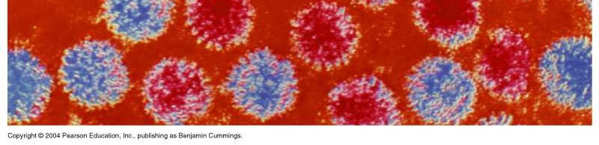
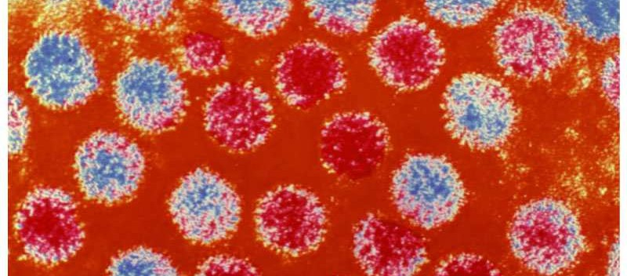
Viral Gastroenteritis
• Rotavirus
moderate to severe vomiting followed by watery diarrhea and fever.
It is the most common cause of food
poisoning in infants and children
• Norovirus
the most common viral cause of adult food poisoning transmitted from water, shellfish, and vegetables contaminated by feces.
• Treated with rehydration (ORT)

Slide 16
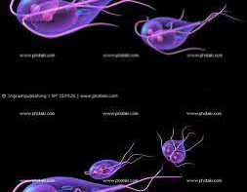
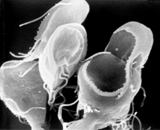
Giardiasis
contaminated
•
Transmitted
by
water
(Symptoms
of
giardiasis
microscopic
parasite
normally begin 1 to
becoming infected.)
3 weeks after
•
Diagnosed
examination trophozoite.
Treated with
Symptoms
•Diarrhea
by
microscopic
of stool for ova
and
•
metronidazole.
•Gas or flatulence
•Greasy stool that can float
•Stomach or abdominal cramps
•Upset stomach or nausea
•Dehydration

Slide 17
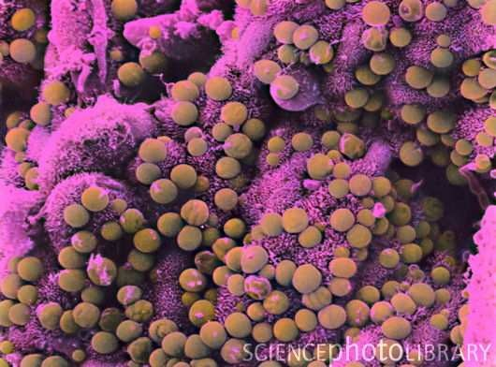
Cryptosporidiosis
•
Cryptosporidium parvum
(protozoan parasite) in contaminated water
Transmitted by oocysts
Diagnosed by acid-fast staining of stool or ELISA
The first signs and symptoms of
cryptosporidium infection
usually appear within a
after infection and may
week
include:
•
•
Watery diarrhea
Dehydration
Lack of appetite
Weight loss
Stomach cramps or pain
Fever Nausea Vomiting
•
Treated with oral
rehydration, Nitazoxanide has been FDA-approved for treatment of diarrhea caused by Cryptosporidium in people with healthy immune systems and is available by prescription. Alinia
Cryptosporidium is one of the most frequent causes of
waterborne disease among humans in the United States.

Slide 18
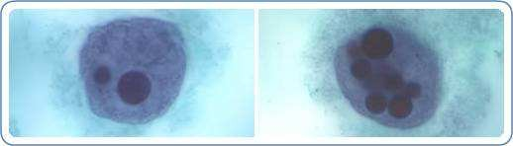
Parasites - Amebiasis (also known as
Entamoeba histolytica infection)
Amebiasis is caused by Entamoeba
Transmitted by contaminated water
or food.
The symptoms are often quite mild
histolytica,
a
protozoan that
is
found
worldwide.
Only
about
10% to 20% of people
who
are
E.
the
and
can include
loose
feces,
infected
histolytica
with
become sick
stomach
cramping.
pain,
and
stomach
from
infection.
How is amebiasis diagnosed?
• Several stool samples several different days.
Treatment:
Metronidazole is the mainstay of therapy for invasive amebiasis.
Amebic dysentery
is a severe form
of
amebiasis
associated
with
from
stomach pain, bloody stools, and
fever.

Slide 19
Acute inflamatory diarrhea
The presence of fever and bloody diarrhea (dysentery)
indicates colonic tissue damage caused by invasion.
(Shigellosis, Salmonellosis, Campylobacter or
Yersinia infection, amebiasis) or toxin (C. difficile, E.coli O157:H7)

Slide 20
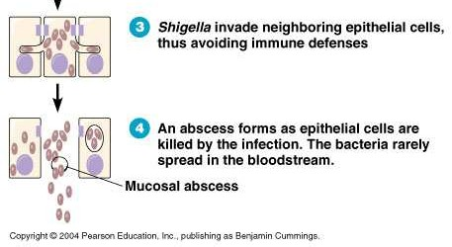
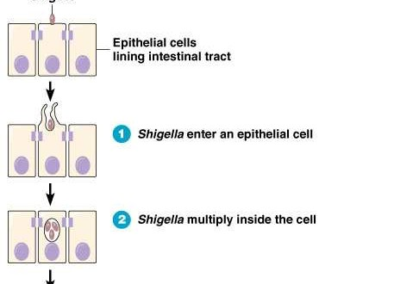
Shigellosis
•
Shigellosis is a bacterial infection that affects the digestive system. Shigellosis is caused by a group of bacteria called Shigella.
•
The
Shigella
bacterium is
spread
through contaminated water or
food or through contact with contaminated feces. The bacteria release Shiga toxins that irritate the intestines.
The primary symptom of shigellosis is diarrhea.
•
•
Shiga
toxin
causes
inflammation
and bleeding
Figure 25.8

Slide 21
Treatment for Shigellosis
Combating dehydration is the main goal of treatment for most cases of shigellosis.
• It is important to drink plenty of fluids, especially electrolyte
solutions, many of which are available over the counter.
• Moderate-to-severe infection may require medical treatment.
• Confirmation of Shigella:
Drug options antibiotic medications:
• azithromycin (Zithromax)
• ciprofloxacin (Cipro)
• co-trimoxazole (Bactrim)

Slide 22
Campylobacter Gastroenteritis
spiral-shaped bacteria
•
Campylobacter jejuni (Usually transmitted eating raw or
undercooked poultry meat, cow's milk).
Most people who become ill with campylobacteriosis get diarrhea, cramping, abdominal pain, and fever within two to five days after exposure to the organism. The diarrhea may be bloody and can be accompanied by nausea and vomiting.
Treatment: Campylobacter recover without any specific
•
•
treatment. Moderate-to-severe
infection
may
require
medical
treatment:
Azithromycin
and
fluoroquinolones
(e.g., ciprofloxacin)

Slide 23


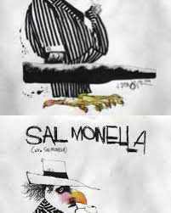
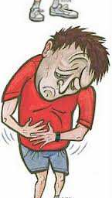
What if Chickens Wanted to Rule the World…would they
Eggs?
Sabotage
Eggs have been the most common food
source linked to SE infections.

Slide 24
Salmonellosis
Salmonella serotype Enteritidis
•
Anyone
can
get
a
Salmonella
infection,
but
the
elderly,
•
•
Symptoms:
diarrhea,
infants,
and
persons
with
fever,vomiting,
impaired immune systems are at
increased illness.
risk
for
serious
and abdominal cramps 12 to 72
hours after infection.
In most cases, the illness lasts
•
•
•
Transmitted by:
four
to
seven
days,
and
most
Poultry, pork, beef and fish (seafood),
people
treatment.
recover
without
cases, the
if the meat is prepared incorrectly
or is
after egg
In
some
infected
with
the bacteria
diarrhea may be so severe that the
preparation.
Infected
eggs,
products, and milk when not prepared,
handled, or refrigerated properly.
Tainted fruits and vegetables
patient
becomes
dangerously dehydrated and must
be hospitalized.
•
Figure 25.9

Slide 25
TREATMENT
• Salmonella gastroenteritis is typically self-limiting,
and antibiotics should not be used in most cases.
• All patients with gastroenteritis should be assessed
for volume depletion and electrolyte imbalances.
• Antibiotics for these high-risk groups include an oral
fluoroquinolone, azithromycin, trimethoprim/sulfamethoxazole, or amoxicillin.

Slide 26
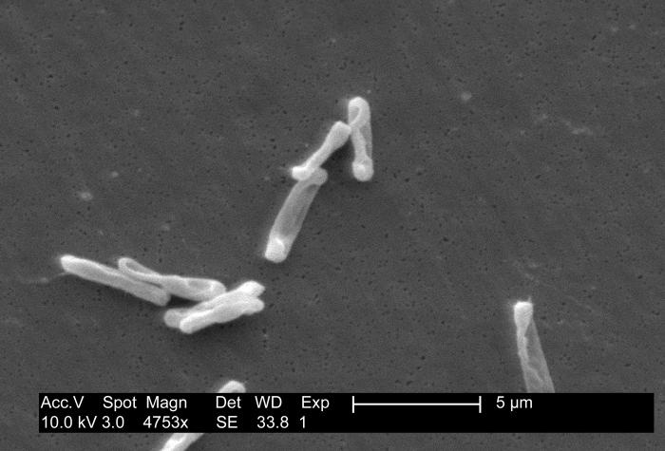
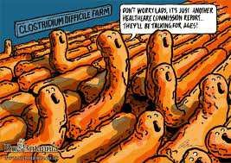
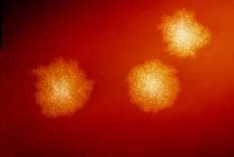
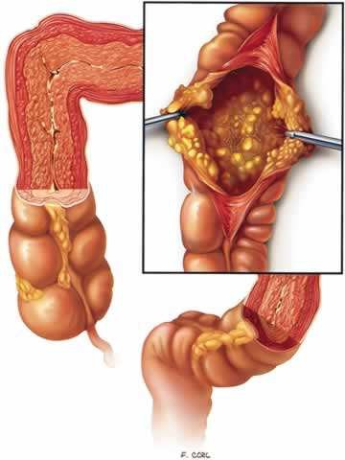
Clostridium
difficile

Slide 27
Clostridium difficile
(G+, anaerob)
• Clostridium difficile infection (CDI) is a bacterial disease of the
gastrointestinal tract
caused
by
C.
difficile,
a
toxinproducing,
Gram-positive, anaerobic, spore-forming bacillus. The infection
occurs most commonly when patients receive antibiotics that alter the normal enteric gut bacteria of the patients allowing overgrowth of C. difficile.
• (Pseudomembranous Colitis , PMC, CDI)
• The PMC may be caused by any antibiotic.

Slide 28
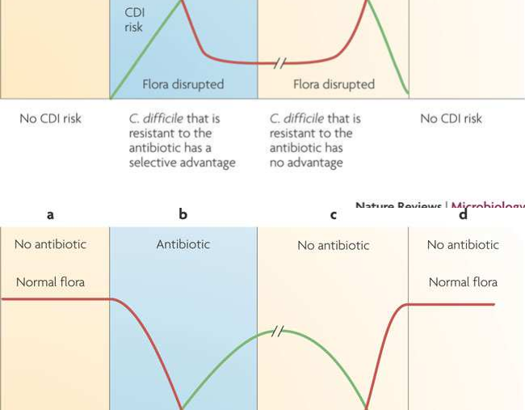
The infection occurs most commonly when
patients receive antibiotics that alter the normal enteric gut bacteria of the patients allowing overgrowth of C. difficile.

Slide 29
Antibiotic-associated diarrhea (AAD)
•
In form one, there is no significant pathogen or toxin of the
diarrhea which begins during the administration of antibiotics; usually dose-related, however, after leaving the antibiotic the diarrhea immediately stops.
In form 2, it is caused by C. difficile,
•
•
The antibiotic modifies the normal intestinal flora which
causes unlimited growth of C. difficile.
The CDI develops into pseudomembranous (PMC) colitis,
In the severe form of the PMC the patient can have watery, bloody stools 15-30/ day.
The diarrhea is usually accompanied by colicky abdominal pain, fever, leucocytosis. Mortality: 10%
•
•
•

Slide 30
The bacterial characteristics
• 1935: Hall and O 'Toole (Bacillus difficilis)
• Gram + spore-forming, anaerobic rods.
It can be found in the environment (soil, water, waste water, hay, sand), animal and human intestinal tract.
The vegetative form of it quickly destroyed by the air but the spores (resistant to heat, dryness and chemical effects).

Slide 31
C. difficile (toxins)
• The toxin-A and toxin-B
• Both
toxins
activate
proinflammatory
monokines
such
as
interleukin
1
(IL-1)
and
tumor necrosis factor (TNF) production.
• B-toxin is very efficient cytopathogenic toxin.
• The harmful effects of these toxins directly or
indirectly
can
generate
microcirculatory
disturbance that causes
and bleeding.
colon mucosal damage

Slide 32
C. difficile colonization rate
• It can be detected in 2-3% of the healthy adults
In the cases of antibiotic-associated diarrhea with a positive toxin assay 90-100% of the stool culture is also positive .
Pathogens can be detected in 5-15% of hospitalized adults without diarrhea getting antibiotic therapy,
The pathogen spores are very often present in surgical intensive care units (chairs, instruments etc) as well. For this
reason, C. difficile disease is
infections.
typically considered
nosocomial

Slide 33
Risk Factors
Antibiotic treatment
Reduction in colonization resistance
Old age> 65 years
Severe illness (septic, malignancy, immunosuppression) PPI, Antidepressants, Methotrexate
Nasogastric tube, PEG
The intensive care unit or nursing management
Invasive interventions Long hospitalization Immunocompromised condition Intestinal ischemia
(IL) -8 genpolymorfism
1.
2.
3.
4.
5.
6.
7.
8.
9.
10.
11.
12.

Slide 34
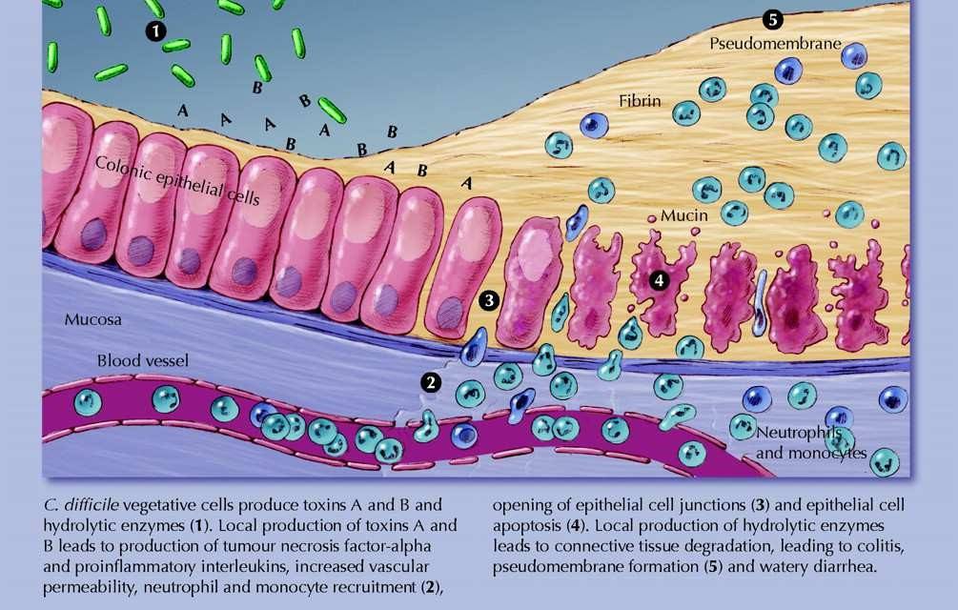
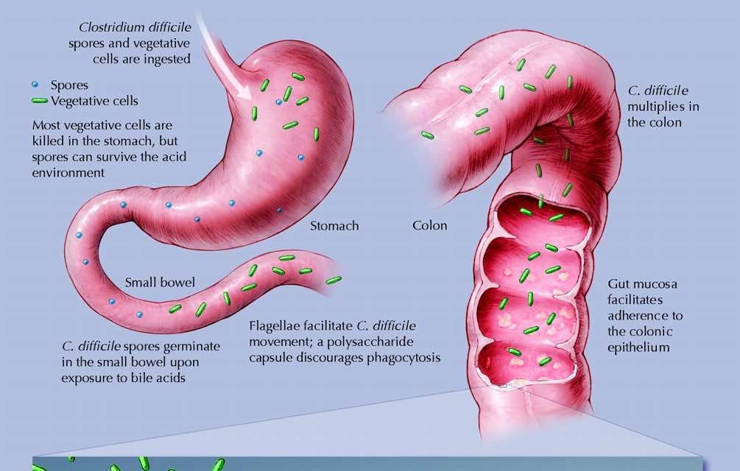
Dr. Krizsán Gergely ScienceDaily, 2011. február 03.

Slide 35
Antibiotic-associated diarrhea (AAD)
Pseudomembranous colitis (PMC) C. difficile
•
•
•
•
- Severe diarrhea >15 or (paralytic condition)
- lethargy
- Fever (> 38.5 ° C), chills
- Hemodynamic instability, severe cases of septic shock
- Dehydration, electrolyte imbalance
- Severe abdominal or diffuse abdominal tenderness,
•
•
abdominal
meteorism
•
- Toxic megacolon (3%)

Slide 36
Diagnostic microbiology tests
Metodhs
Sensitivity /
specificity
Advantages
Disadvantages
Citotoxin
assay
Toxin B
+++ / +++
Gold standard
slow: 24-48 h
requires tissue
culture
Enzim
immunoassay
Toxin A or A+B
++ / +++
fast
simple
specific
less
sensitive
Latexagglutiná- ció
bacterial enzyme
+ / +
fast
simple
specific
low
sensitivity
specificity
Stool culture
Clostr. difficile
+++ / +
sensitive
slow: 2-5 days
nonspecific
PCR
toxin A vagy B
gének
+++ / +++
sensitive
specific
special laboratory

Slide 37
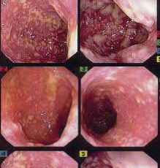
The colonoscopy is most secure way in
detection of disease. In most cases distal colon is involved in the PMC;
the
the
Diagnosis
in
this case
the sigmoidoscopy
is
the
sufficient, however, in one third of
cases only the right colon is involved, so if
possible, the
examined.
entire
colon
should
be
Endoscopically:
2-10 mm diameter,
-
-
-
Prominent
Adherent
Yellow plaques

Slide 38
Treatment
The incidence of C difficile infection has tripled in the past 10 years. Partly become virulent pathogens were partially responsive patients. The literature distinguishes four clinical forms:
• short-term colonization,
• acute diarrhea,
• fulminant diarrhea,
• recurrent infection,
• The current treatment options have not had the full success.
N Engl J Med. 2011;364:422-431, 473-475. Abstract

Slide 39
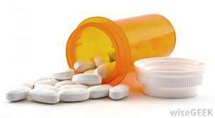
Treatment
Lab result
Recommendation
First episode of mild to moderate
WBC 15 ezer/µl
Kreatinin < 150
µmol/l
Metronidazol 3x500mg per os 10-14 days
First serious episode
Fvs szám > 15 ezer/µl
Kreatinin >150 µmol/l
Vancomycin 4x125mg per os 10-14 days
First episode of serious complications
Hypotonia
Shock
Ileus, megacolon
Vancomycin 4x125 mg per os or
NGT+ metronidazol 3x500mg iv +
vancomycin enema
Relapse - first
20-27%
The earlier effective treatment to be administered.
Relapse - second
(over 60%)
Vancomycin 4x125mg (4x500 mg) per os 10-14 days, or every third day
Fidaxomicin 2x200 mg /10 days
Fecal transplantation ??
125mg daily intermittent-

Slide 40


Fecal Transplant
• high recovery rate ~ 92%
• low recurrence rate ~ 6%
• safe
• cost effective
• simple
• fast
• potentially life-saving

Slide 41
Donors
• Suitable:
• In close contact with the patient, but he or she
does
not live in
the
same
household
•
•
•
-
-
-
Healthy
Young
Voluntary

Slide 42
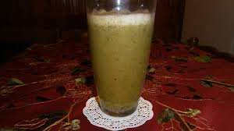
Fecal Transplant
feces in a centrifuge
Benefits Colonoscopy,
Benefits of NG, NJ tube,
•No contaminated small bowel syndrome
•No pneumonia
•There is no serious risk of
perforation
•It does not require professional tools (endoscope)
•Not too burdensome
•No regurgitation, aspiration
•Large quantities of transplantable
•Accumulates at the infection site
•Transplantation can be used in the event of subileus
•the gastric acid does not reduce the effect of fecal transplant.

Slide 43
Indications
First serious relapse after a successful treatment of severe pseudomembranous colitis
• Third recurrence after a successful treatment of
pseudomembranous colitis
Treatment-resistant chronic pseudomembranous colitis, which causes protein losing enteropathy

Slide 44

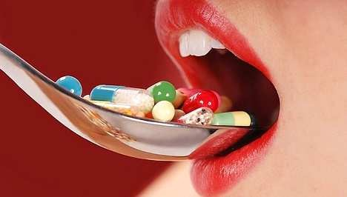





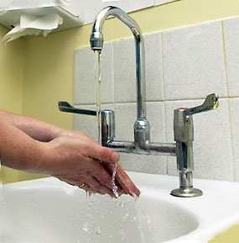
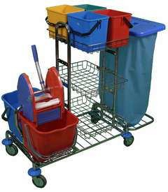
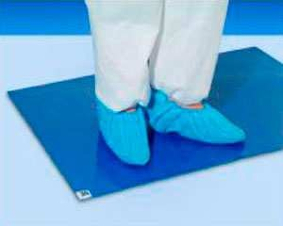
PREVENTION

Slide 45
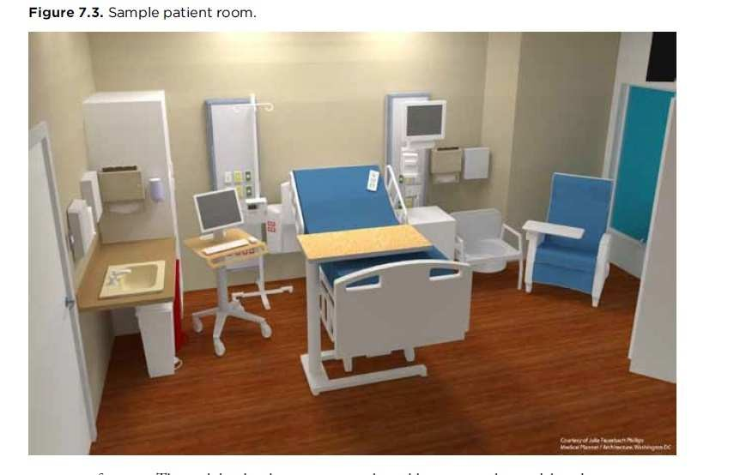
PREVENTION
against
CDI
• Single-contact-comfort room,
• Designated toilet
• Cohort isolation possible (ward, department)
• Qualified staff
• Personalized tools
Cleaned and disinfected immediately (after use tools)
• Disposables apply
The isolation can be unlocked after 48 hours (after recovery)

Slide 46
Hand hygiene, protective clothing,
environmental disinfection
• Careful handwashing with
•
Continuous disinfection
with sporocid spectrum disinfectant (chlorine)
Disinfecting the frequently touched
soap - after removal
gloves
• Alcohol-based hand
of
•
disinfectants are
not
recommended
surfaces
Toilet is a frequent source of Cl. Difficile spores
Final disinfection
•
Protective Device
• Gloves
• Cape and apron
•

Slide 47
Pancreatitis
•
Pancreatitis is a disease
in which the pancreas becomes inflamed. Pancreatic damage happens when the
•
In most cases, acute
pancreatitis is caused by gallstones or heavy alcohol use. Other
causes include
digestive enzymes are
activated before they are
medications, infections,
trauma, metabolic disorders, and surgery. In up to 30% of people with acute pancreatitis,
the cause is unknown.
released into
intestine and attacking the
the small
begin pancreas.

