Slide 1


SOLUTION
OF
NON-
ELECTROLYTES

Slide 2
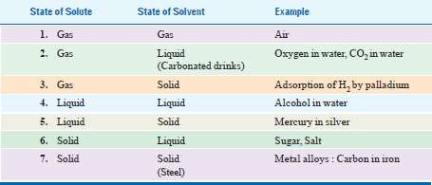
What is a solution?
• A solution is a homogeneous mixture
• A solute is dissolved in a solvent.
• Solute is the substance being dissolved
• Solvent is the medium in which the solute dissolves
• An aqueous solution has water as solvent
2

Slide 3





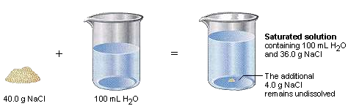
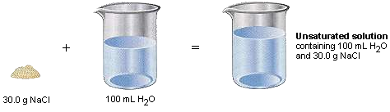
SATURATED – contains the
max. no. of solute that dissolves at that temperature
Solution
Unsaturated
Saturated
SUPERSATURATED –
Contains more than is
possible
and
are
unstable
Supersaturated
Unsaturated solution Saturated solution
3

Slide 4
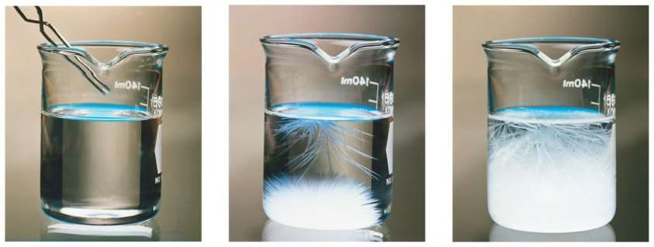
Super saturated solution
➢Solvent holds more solute than is normally possible
at that temperature.
➢These solutions are unstable; crystallization can often be stimulated by adding a “seed crystal” or scratching the side of the flask.
4

Slide 5
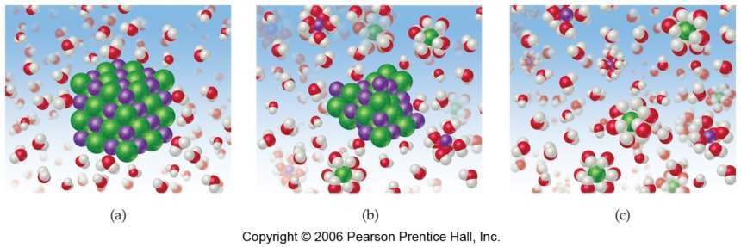
How Does a Solution Form?
1.
2.
3.
Solvent molecules attracted to surface ions.
Each ion is surrounded by solvent molecules.
Enthalpy (ΔH)
formed.
changes
with
each
interaction
broken
or
5

Slide 6
It
1.
is a 3 step process
Separation of Solute
•
•
Must overcome IMF or ion-ion attractions in solute
Requires energy, ENDOTHERMIC ( + ΔH)
2.
Separation of Solvent
Must overcome IMF of solvent particles
Requires energy, ENDOTHERMIC (+ ΔH)
•
•
3.
Interaction of Solute & Solvent
Attractive bonds form between solute particles and solvent
particles
“Solvation” or “Hydration” (where water = solvent)
Releases energy, EXOTHERMIC (- ΔH)
•
•
•
6

Slide 7
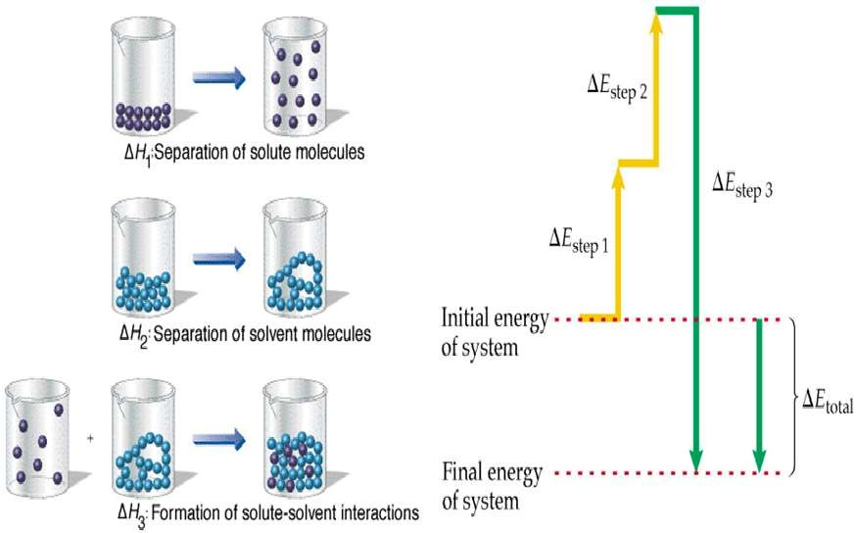
7

Slide 8


WAYS OF EXPRESSING
CONCENTRATIONS
OF
SOLUTIONS
8

Slide 9
mass of solute
%(w / w) =
x 100
mass of solution
mass of solute
%(w / v) =
x 100
volume of
solution
volume of solute
%(v / v) =
x 100
volume of solution
Mass Percentage
9

Slide 10
•
•
•
•
•
Wt. of solute (NaCl) = 1.75 g
Wt. of solvent (H2O) = 5.85 g
∴ Wt. of solution = 1.75 + 5.85 = 7.60 g
Hence concentration of NaCl % by weight
1.75/ 7.60 X 100 = 23.0
What is the per cent by weight of NaCl if 1.75 g
of NaCl is dissolved in 5.85 g of water
10

Slide 11
Parts
Parts
per
per
Million (ppm)
Billion (ppb)
and
6
ppm =
Mass of A in solution
X
10
Total massof solution
9
ppb =
Mass of A in solution
X
10
Total massof solution
11

Slide 12
moles of A
XA
=
total
moles
in
solution
Mole Fraction (X)
12

Slide 13
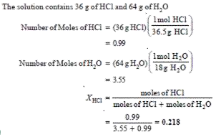
Calculate the mole fraction of HCl in a solution of hydrochloric
acid in water, containing 36 per cent HCl by weight
14

Slide 14
mol of solute
M =
L of solution
• Because volume is temperature dependent,
molarity can change with
• Unit = mol/ litre
temperature.
Molarity (M)
15

Slide 15
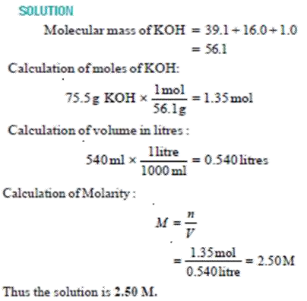
What is the molarity of a solution prepared by
dissolving 75.5 g of pure KOH in 540 ml of solution.
16

Slide 16
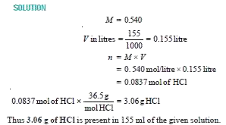
What weight of HCl is present in 155 ml of a 0.540 M
solution
17

Slide 17
mol of solute
m =
kg of solvent
• Because neither moles nor mass change with
temperature, molality (unlike
temperature dependent.
• Unit = mol/ kg
molarity)
is
NOT
Molality (m)
18

Slide 18
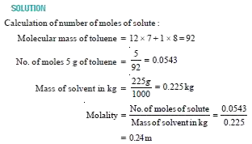
What is the molality of a solution prepared by dissolving 5.0 g
of toluene (C₇H₈) in 225 g of benzene (C₆H₆) ?
19

Slide 19
• The normality of a solution is the gram equivalent weight
of a solute per litre of solution.
• Normality is the only concentration unit that is reaction
dependent.
Gram equivalent weight of solute
Normality =
Litre of solution
Normality (N)
20

Slide 20
• It is the mass of one equivalent, that is the mass of a
given substance which will:
• Supply or react with one mole of hydrogen cations
an acid–base reaction; or
H⁺
in
• Supply or react with one mole of electrons
reaction.
e⁻
in a redox
• It is that weight of any atom/molecule which displaces
1.008 g of H, 19 g of F or 8 g of O.
Equivalentweight=
molecularweight
equivalent/mole
Equivalent weight (g/Eq)
21

Slide 21
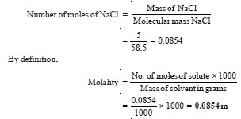
5 g of NaCl is dissolved in 1000 g of water. If the density of the
resulting solution is 0.997 g/ml, calculate the molality, molarity, normality and mole fraction of the solute, assuming volume of the solution is equal to that of solvent
22

Slide 22
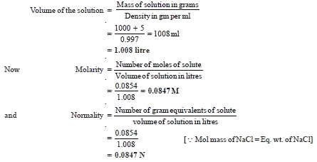
23

Slide 23
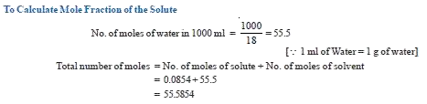

24

Slide 24






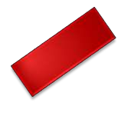



25

Slide 25
• Avogadro hypothesized that there was a specific number
that would represent the number of atoms or molecules in
a mole of that atom or molecule.
• The weight of that unit known as a mole would be
equivalent to the molecular weight of the atom or
molecule in grams. (Mole = Molecular
weight
in
grams)
Avogadro Number
26

Slide 26
• According to this theory, one mole of carbon-12 would have a
mass of 12 grams because carbon-12 has an atomic weight
12.
of
• One mole of hydrogen would weigh one gram
• It would contain the same number of atoms as one mole of
carbon.
• The magical number was, in fact, discovered to be 6.023E²³
(6.023 X 10²³)
27

Slide 27
SOLUTIONS OF
LIQUID
✓Ideal and Real solutions
✓Raoult’s Law
✓Deviation from Raoult’s law
LIQUID
IN
28

Slide 28







Solutions
of liquid
Liquid pairs
in
liquid
Completely
miscible
Partially
miscible
Completely
immiscible
Real
solutions
Ideal
solutions
29

Slide 29
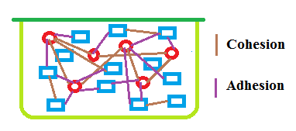



Ideal
solutions
Cohesion
Adhesion
30

Slide 30

• No heat is evolved or absorbed during
mixing
• Final volume of sol.= sum of both.
• The properties of solution such as vapour
pressure, surface tension, viscosity etc
are
the
average
of
the
two
pure
liquids.
31

Slide 31
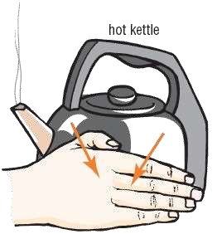
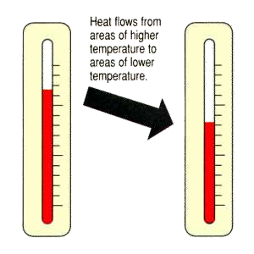
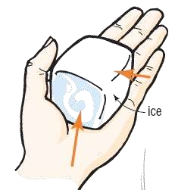
Quantitative measure:
 Pure substance: Molar free energy
 Constituent of a solution: Partial molar free energy or
chemical
potential
Escaping tendency
32

Slide 32
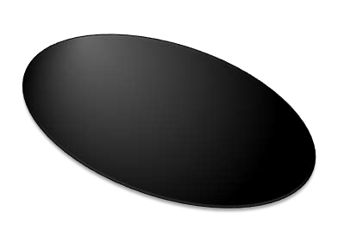
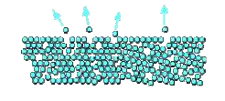
Ideal mixtures and
forces
In a pure liquid, some of the more energetic molecules have enough energy to overcome the intermolecular attractions and escape from the surface to form vapour.
• The smaller the intermolecular
forces, the more molecules will be able to escape at any particular temperature
intermolecular
a
Liquid A
33

Slide 33
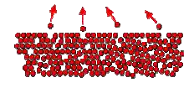
• If you have a second liquid, the same thing is true.
• At any particular temperature a certain escaping tendency
Liquid B
34

Slide 34
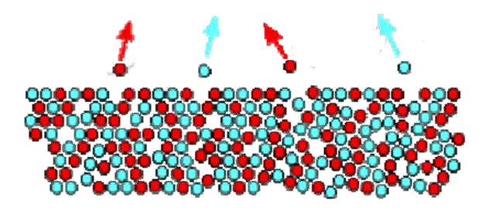



1:1
Solution of A + B
• In an ideal mixture of these two liquids.
• There will be equal evaporation and hence equal vapour
pressure
35

Slide 35

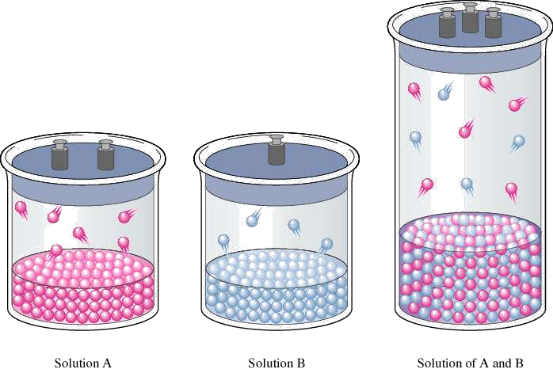

Vapour pressure
• Vapour pressure or equilibrium vapour pressure is the pressure of a
vapour
cl
in
thermodynamic
equilibrium
with
its
condensed
phases
in
a
3:2
osed system.
36

Slide 36
Raoult’s Law (1887)
• Partial vapour pressure of each volatile constituent is equal to the
vapour pressure of the pure constituent multiplied by its mole
fraction in the solution. Thus,
PA = PA°
PB = PB°
for two constituents A and
XA
XB
B,
PA and PB – partial vapour pressure
XA and XB – mole fraction concentration
PA° and PB° - vapour pressure of pure components
• The total vapour pressure of the mixture is equal to the sum of
the individual partial pressures.
Total Vapour Pressure = PA + PB
37

Slide 37
• E.g. if vapour pressure of ethylene chloride in the pure
state is 236 mm Hg at 50°C, then in a solution consisting of a mole fraction of 0.4 ethylene chloride and 0.6
benzene, the partial
vapour pressure of
ethylene
chloride
is
40%
of
236
mm.
PA = PA° XA
Pec
Pec
Pec
=
=
=
Pec° Xec
236 X 0.4
94.4
mm
38

Slide 38
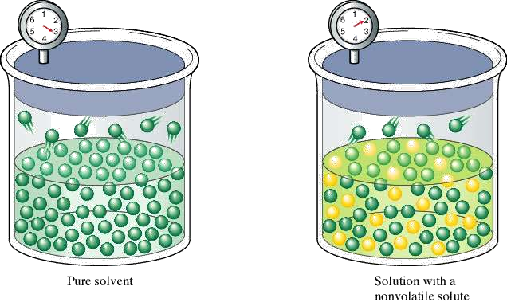



Escaping tendency decreases
The presence of a non-volatile solute means that fewer solvent
particles are at the solution’s surface, so less solvent evaporates!
39

Slide 39
•
Thus, in an ideal solution, when liquid A is
mixed with liquid B in a manner depending on the mole fractions of A and B present in the final solution.
This will diminish the escaping tendency of
each constituent, leading to a reduction in the
•
rate of escape of the molecules of A and B
the surface of liquid.
The total pressure is the sum of the partial
pressures of all the constituents.
P = PA + PB
from
•
40

Slide 40
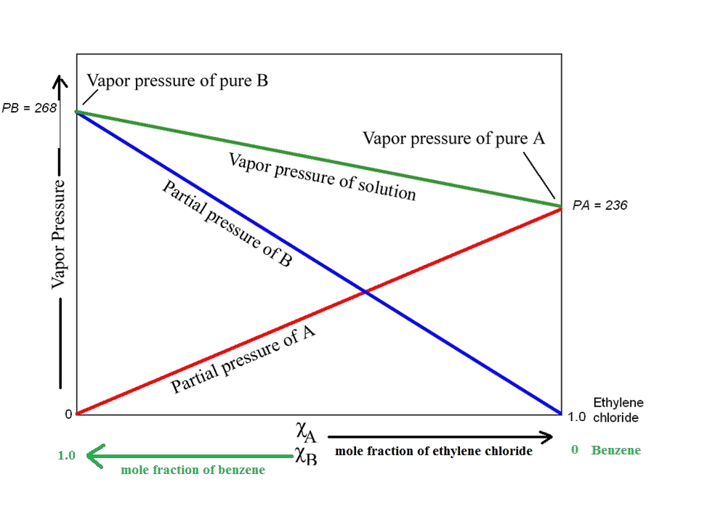
41

Slide 41

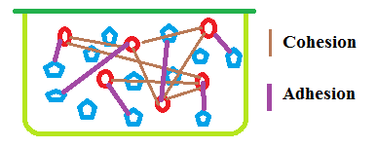
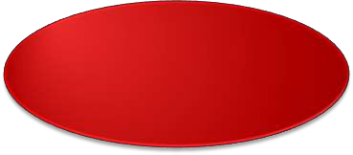



Real
Solutions
Do not adhere to
Raoult’s law
Adhesion
Cohesion
OR
Adhesion
Cohesion
42

Slide 42


Deviation from
Raoult’s
Law
Positive Deviation
Negative deviation
43

Slide 43
Negative
Cohesion
deviation
Adhesion
These are cases
where
the molecules break
away from the mixture LESS easily than they do from the pure liquids.
New STRONGER forces must exist in the mixture than in the original liquids.
A↔B 〉〉 A↔A, or B↔B
Vapour pressure
of
solution less than expected
44

Slide 44
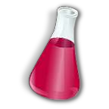
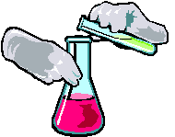
Acetone
(B)
Solution of acetone in
chloroform
Chloroform (A)
45

Slide 45
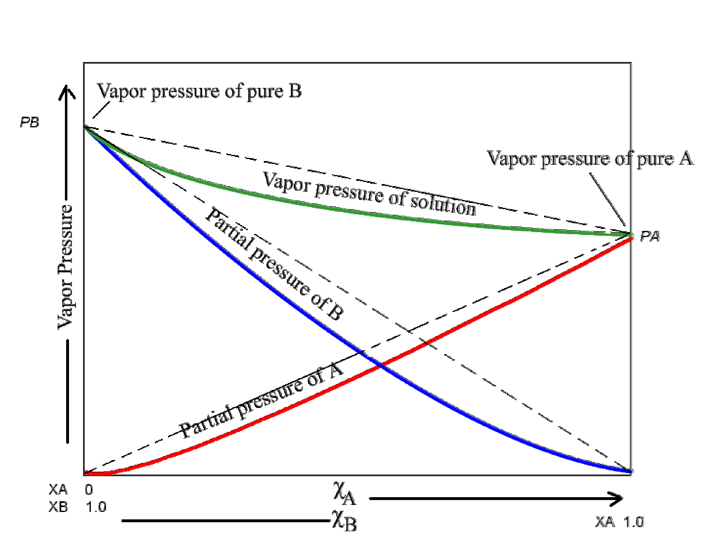
46

Slide 46
• Dilution of chloroform (A) by the addition of acetone (B).
• Addition of B to A tends to reduce the vapour pressure of A to a
greater extent than can be accounted for by the simple dilution.
• Chloroform and acetone manifest such attraction for one
another through the formation of a hydrogen bond further
reducing
the
escaping
tendency
of
each
constituent.
47

Slide 47
This pair forms weak compound, Cl₃C-H…O=C(CH₃)₂
which
can
be
isolated
and
identified.
Cl
CH3
C
H
O
C
Cl
CH3
Cl
Reaction between dipolar
molecules, or between a dipolar
and a non polar molecule, may also lead to negative
deviations.
48

Slide 48


Positive deviation
Cohesion
Adhesion
These are cases where the
molecules break away
from the mixture
MORE easily than they do from the pure liquids. New WEAKER forces
must exist in the mixture than in the original liquids. A↔B << A↔A, or B↔B
Vapour pressure
of
solution greater than
expected
49

Slide 49





Chloroform
(B)
Solution of
ethyl
chloroform in
alcohol
Ethyl
alcohol (A)
Other
examples
Carbon
disulphide +
Benzene + Ethyl
alcohol
Acetone
50

Slide 50
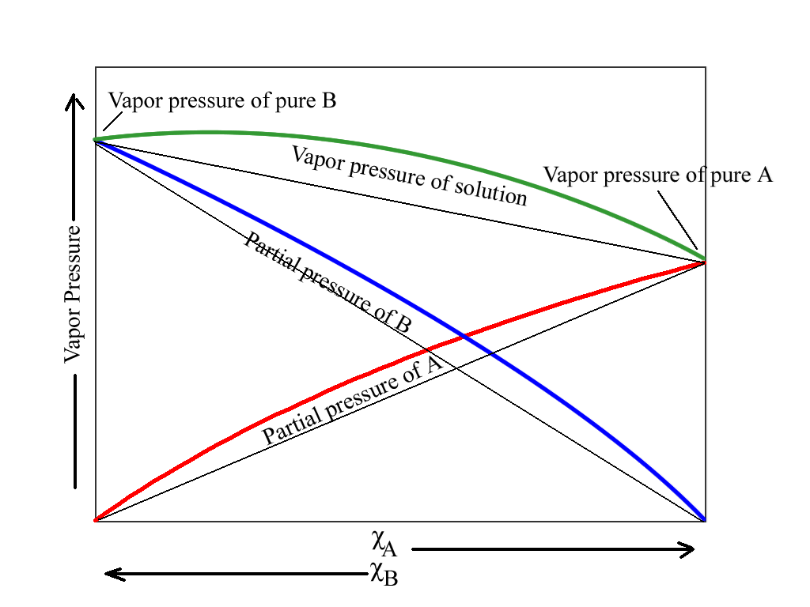
51

Slide 51
• Raoult’s law describes the behavior of either of the
component of a real liquid pair only when that substance is present in high concentration and thus is considered to
be the solvent.
• In such a situation Raoult’s law can be expressed as
Psolvent = P°solvent Xsolvent
It is valid only for the solvent of a nonideal solution that is sufficiently dilute with respect to the solute. It cannot
hold for the component in
low
concentration,
that
is,
the
solute
in
a
dilute
solution.
52

Slide 52
Real
solutions
In real solutions the concentration of solute is high
and the intermolecular forces between solute-solute
and solute-solvent are high. This causes deviations.
Volatile
solute
It is applicable to only non-volatile solute. As volatile
solutes contribute to the vapour pressure which may
cause deviation.
Solutes
which
associate or
dissociate
If it associates it leads to reduction in lowering of
vapour pressure and if it dissociates then pressure lowering would be increased.
vapour
Limitations of Raoult’s
law
53

Slide 53

1)
• Uses Raoult’s law.
• It has a drug and a propellant.
• Common propellants used:
• Trichloromonofluoromethane (propellant 1
• Dichlorodifluoromethane (propellant 12)
AEROSOLS
58

Slide 54

• The effect of partial pressure on solubility of gases
At pressure of few atmosphere or less, solubility of gas solute follows Henry Law which states that the amount of
solute gas dissolved in solution is directly
proportional
to
the amount of pressure
above
the
P
solution
c
=
k
c = solubility of the gas (M)
k = Henry’s Law Constant
P = partial pressure of gas
Henry’s Law
59

Slide 55
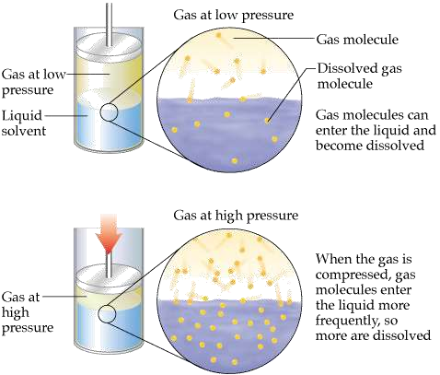
60

Slide 56
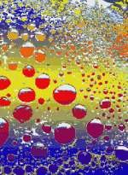

Henry’s
Law & Soft Drinks
• Soft drinks contain “carbonated water” –
water with dissolved carbon dioxide gas.
The drinks are bottled with a CO₂ pressure greater than 1 atm.
When the bottle is opened, the pressure of CO₂ decreases and the solubility of CO₂
also decreases, according to Henry’s Law.
• Therefore, bubbles of CO₂ escape from
solution.
61

Slide 57
Henry’s
law
applies
to
the
SOLUTE
and
Raoult’s
law
applies
to
the
SOLVENT
in
dilute
solutions
of
real
liquid
pairs.
62

Slide 58
COLLIGATIVE
SOLUTIONS
PROPERTIES
OF
63

Slide 59








Properties of solutions
Solutions have properties different from both solute and solvent
• 4 types of properties
Additive &
Constitutive
Additive
Constitutive
Colligative
64

Slide 60
• Additive Properties: Additive properties are those
properties which is the sum of the corresponding
properties of the atoms constituting the molecule.
These properties only depend on the types of the atom and their numbers
• e.g., mass is a additive property, similarly molar volume
is also a good example of additive properties.
Additive properties
65

Slide 61
• Constitutive property of a molecule is the property which
depends upon the constitution of the molecule
i.e., upon the arrangements of atoms within the molecule e.g.,
• Optical activity.
Constitutive properties
66

Slide 62
• The physical property which depend upon the number of
atom in a molecule as well as their
• e.g., atomic volume, parachor etc.
constitution
Additive and constitutive
properties
67

Slide 63
• Colligative properties are those properties, which depends
upon the number of molecules present in a substance
• e.g., vapour pressure of gas, elevation in boiling point,
depression of freezing
solution, etc.
point, osmotic pressure of
the
Colligative
properties
68

Slide 64

Lowering of vapour
pressure
69

Slide 65
•
•
Pressure is measured with a manometer
When a non volatile solute is combined with a volatile solvent, the vapour above the solution is provided by the solvent only.
Solute reduces the escaping tendency of solvent. Vapour pressure of a solution containing a non volatile solute is lowered proportional to the relative number of the solute molecules.
Therefore the vapour pressure of the solvent, P1 is identical to the total pressure of the solution, P.
•
•
•
Lowering of vapour pressure
70

Slide 66

Escaping tendency decreases
The presence of a non-volatile solute means that fewer solvent
particles are at the solution’s surface, so less solvent evaporates!
71

Slide 67
• It is more convenient to express the vapour pressure
of the solution in terms of concentration of solute
rather than the mole fraction of solvent
The sum of the mole fractions of the constituents in a solution is unity:
X1 + X2 = 1
X1 = 1 – X2
Where,
• X₁ is the mole fraction of the solvent; and
• X₂ is the mole fraction of the solute.
72

Slide 68
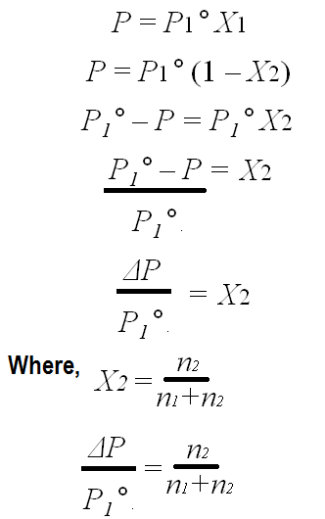
Raoult’s
eq.
In the above eq.
ΔP = P1° – P is the lowering of the vapour pressure; and
ΔP / P1° is the relative
vapour
pressure
lowering.
73

Slide 69

Determination of vapour pressure of solutions
1.
2.
3.
Manometer - Isopiestic method
Hill and Baldes Apparatus
Wescor Method
74

Slide 70






Methods
Static
Dynamic
Barometric
method
Manometer
– isopiestic
method
Hill and
Baldes
method
Wescor
method
Ostwald
Walker
Methods for
determination
of vapour pressure lowering
75

Slide 71
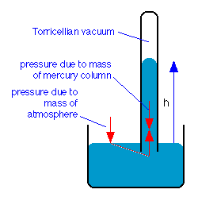
•
Raoult measured the individua
l
and
e of e
able of
vapour
pressure
of
a liquid
then the solution by this method.
He introduced the liquid or th solution into Toricellian vacuum
a barometer tube and measured th
depression of the mercury level.
This method is neither practic
•
•
nor
accurate
as
the lowering
vapour pressure is too small.
Barometric Method
76

Slide 72
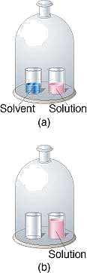
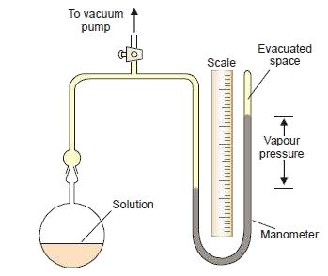


Manometer
Vapour pressure lowering is obtained by subtracting the vapour pressure of the solution from the vapour pressure of the pure solvent.
Vapour
pressure
Vapour pressure
of solvent
Vapour p7re7ssure
of solution
lowering

Slide 73
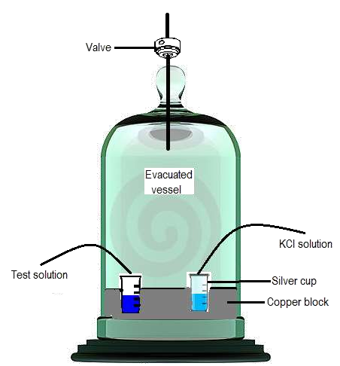
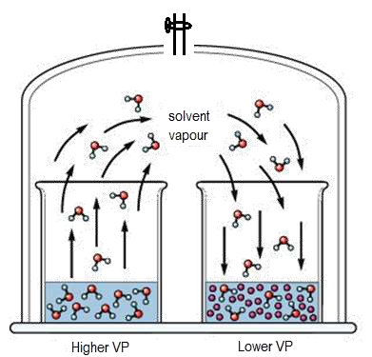
Isopiestic
method
is
used
for
precise determination of vapour pressures.
The vapour pressure of KCl solution of various
concentrations have been determined accurately
and thus the vapour pressure of the test solution
that is isopiestic is thus readily obtained.
Apparatus for the isopiestic method
78

Slide 74
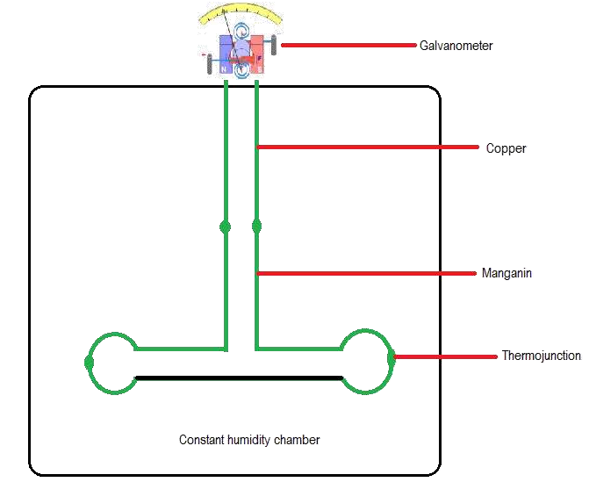
Hill
and
Baldes
Apparatus
79

Slide 75











It consists of combination
of wires of different alloys
formed onto two loops and
connected to a
galvanometer.
This thermoelectric method
measure the change in
potential with respect to
change in vapour pressure.
Used for determining the
relative vapour pressure of
small amounts of liquids.
Vapour pressure lowering
of solution is then obtained
from a standard curve of
vapour pressure versus
galvanometer readings of
potential.
The solution of known
vapour pressure and an
unknown evapourate in a
chamber maintained at
constant humidity.
This method is used to
study the colligative
properties of ophthalmic
solutions.
80

Slide 76
•
•
•
•
It is the fastest and easiest method of determining osmolality.
Therefore it is the method of choice for most of the fluids in biology and medicine in which water is the solvent.
The test solution is absorbed onto a filter paper disk which is usually 2 to 10 µL.
The disk is placed in a sealed chamber near the thermocouple, which is cooled below the dew point of the solution.
Thermocouple is then equilibrated to the dew point of the solution whereupon its potential is recorded.
The potential determined is proportional to the vapour pressure lowering.
Reference standard solutions are used to calibrate the
potential readings against known vapour pressures at the ambient temperature.
Wescor vapour pressure osmometer.
•
•
•
81

Slide 77
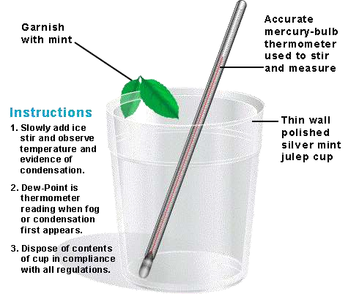
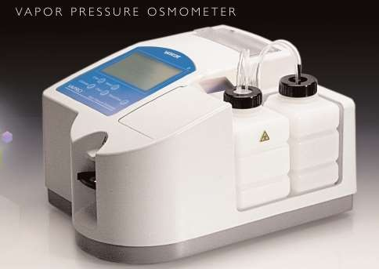
82

Slide 78
• This instrument has been applied to quantitating sodium in
isotonic solutions and studying the colligative properties of parenteral solutions.
• This instrument is also called as vapour pressure
differentiometers
operation.
as
it
does
not
involve
membrane
diffusion
83

Slide 79
•
In this method the relative lowering of vapour pressure can be determined straightway.
The measurement of the individual vapour pressures of a solution and solvent is thus eliminated.
Procedure. The apparatus used by Ostwald and Walker is shown in Fig. It
consists of two sets of bulbs :
(a) Set A containing the solution
(b) Set B containing the solvent
Each set is weighed separately. A slow stream of dry air is then drawn by
suction pump through the two sets of bulbs.
At the end of the operation, these sets are reweighed.
From the loss of weight in each of the two sets, the lowering of vapour pressure is calculated.
The temperature of the air, the solution and the solvent must be kept
constant throughout.
•
•
•
•
•
•
Ostwald and Walker’s Dynamic
Method (Gas Saturation Method)
84

Slide 80
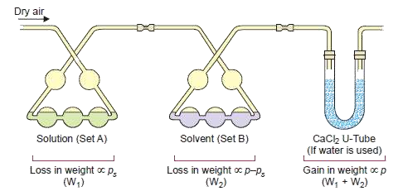
85

Slide 81
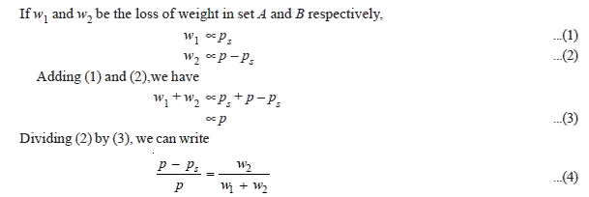
86

Slide 82
• Knowing the loss of mass in set B (w2) and the total loss of
mass in the two sets (w1 + w2), we can find the relative
lowering of vapour pressure from equation (4).
If water is the solvent used, a set of calcium chloride tubes (or a set of bulbs containing conc. H₂SO₄) is attached to the end of the apparatus to catch the escaping water vapour.
• Thus the gain in mass of the CaCl₂-tubes is equal to (w1 +
w2), the total loss of mass in sets A and B.
87

Slide 83
VAPOUR PRESSURE
OF
LIQUID-
LIQUID
SOLUTIONS
88

Slide 84
• The study of the vapour pressures of mixtures of
completely miscible liquids has proved of great help in
the separation of the liquids by fractional distillation.
The vapour pressures of two liquids with varying composition have been determined at constant temperature.
• By plotting the vapour pressure against composition it
has been revealed that, in general, mixtures
miscible liquids are of three types.
of
the
89

Slide 85
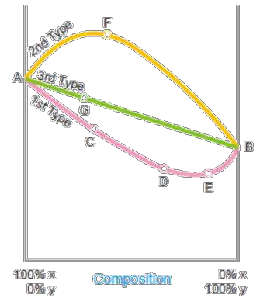
Miscible liquids
1.
First Type of Mixtures of Miscible
Liquids (Maximum boiling point azeotropic solutions)
Second Type of Mixtures of
Miscible Liquids (Minimum boiling
point azeotropic solutions)
2.
3.
Third Type
Liquids
of
Mixtures
of
Miscible
90

Slide 86
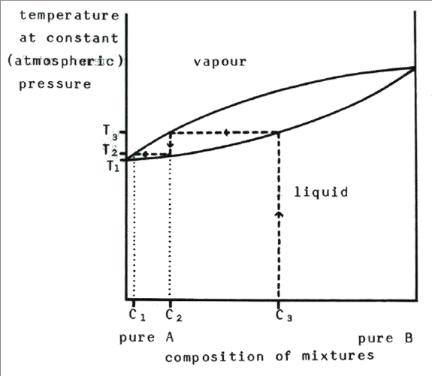
91

Slide 87
Azeotrope / Azeotropic Mixture
• Very large deviations from ideality lead to a special class of
mixtures known as azeotropes, azeotropic mixtures, or constant-boiling mixtures.
• Azeotrope is a special class of liquid mixture that boils at a
constant temperature at a certain composition.
• At this condition, it behaves as if it was one component with
one constant boiling point.
92

Slide 88
•
For this type of solutions the vapour pressure curve
exhibits a minimum.
If we take a mixture which has an excess of X (more
volatile component), we are somewhere at C on the
curve.
When this is distilled the vapour will contain excess of X
and thus the remaining mixture will get richer in Y.
Finally we reach the point D where vapour pressure is minimum and thus boiling point is maximum.
Here the mixture will distil unchanged in composition.
•
•
•
•
First Type of Mixtures of Miscible
Liquids (Maximum boiling point azeotropic solutions)
93

Slide 89
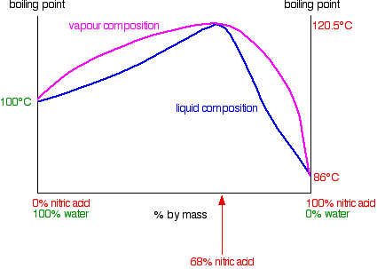
94

Slide 90
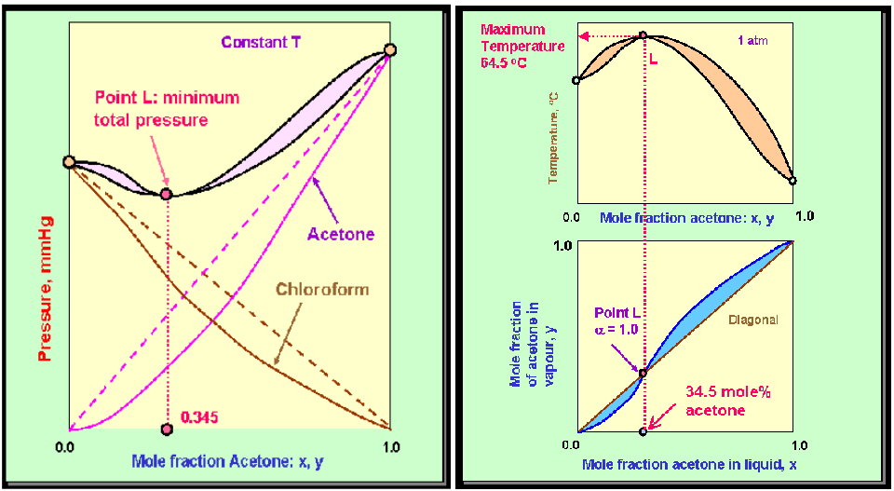
95

Slide 91
• It is obvious that complete separation of this type of
solutions into components is impossible.
At best it can be resolved into one pure component and the constant boiling mixture.
• Solutions of this type which distil unchanged at a
constant temperature and show a maximum boiling point
are
called
maximum
boiling
point
azeotropic
solutions.
96

Slide 92


It occurs when the negative deviations are very large
The total pressure curve in this case passes through a minimum, giving rise to a maximum in
the temperature (i.e. boiling point)
EXAMPLES
Hydrochloric acid - Water (11.1 mole% HCl, 110 ºC, 1 atm)
Acetone - Chloroform (65.5 mole% chloroform, 64.5 ºC,
1 atm)
Nitric acid – Water (68 mole% HNO₃ 120 ºC, 1 atm)




Maximum boiling
azeotropes
97

Slide 93
• Ethanol and water mixtures offer a good example of this
type.
• Ethanol-water mixture containing 95.6 per cent ethanol
boils at the minimum temperature 78.13°.
Thus it is very difficult to obtain pure absolute alcohol by distillation.
This difficulty has, however, been overcome by adding benzene which form a low boiling mixture with water and on distillation it comes over leaving pure ethanol behind.
Second Type of Mixtures of Miscible
Liquids (Minimum boiling point azeotropic solutions)
98

Slide 94
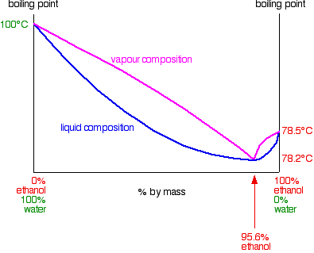
99

Slide 95
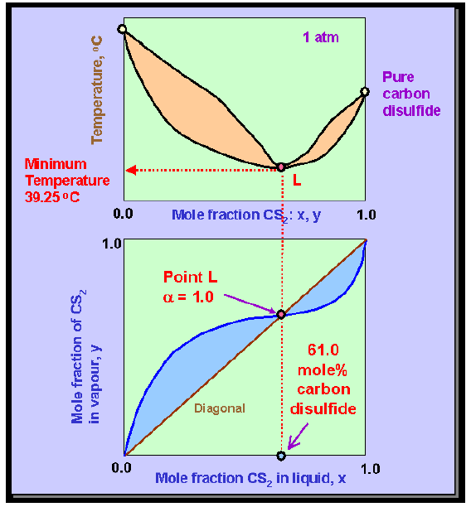

100

Slide 96
• OTHER EXAMPLES
• Ethanol-Water system which at 1 atm occurs at 89.4
mole percent ethanol and 78.2 ºC.
• Carbon disulfide – Acetone 61.0 mole% CS₂, 39.25 ºC,
1 atm
• Benzene - Water (29.6 mole% H₂O, 69.25 ºC, 1 atm)
101

Slide 97
•
In this case the vapour pressures of mixtures always lie between
the vapour pressures of pure components and thus the vapour- pressure composition curve is a straight line.
Suppose we have a mixture containing excess of Y which is
represented by point G on the curve.
On distillation X component being more volatile will be obtained in greater proportion in the distillate and we gradually travel along the curve AB.
The latter fractions will, of course, be poorer in X and richer in Y
•
•
•
till we reach the 100 per cent Y-axis, when all the X will
passed over.
have
Third Type of Mixtures of
Miscible Liquids
102

Slide 98
• Only in this type of solutions we can completely separate
the components by fractional distillation.
Thus methyl alcohol-water mixtures can be resolved into pure components by distillation.
• Liquid mixtures which distil with a change in
composition
are
called
zeotropic
mixtures
103

Slide 99

Distillation is a widely used method for separating
mixtures based on differences in the conditions required to change the phase of components of the mixture.
To separate a mixture of liquids, the liquid can be heated
to force components, which have different boiling points,
into the gas phase.
The gas is then condensed back into liquid form and
collected.
Vapourization of a liquid and subsequent condensation



of the resultant gas back
to
liquid
form
–
Distillation
Distillation
104

Slide 100


105

Slide 101

106

Slide 102








Boiling point
 The boiling point of an element or a substance is the temperature at which the vapour pressure of the liquid equals
the environmental
Hg)
pressure surrounding
the liquid (760 mm
Boiling
point
Vapour
pressure
Atmospheric
pressure
107

Slide 103






Boiling
point
Vapour
pressure
Volatile
108

Slide 104

109

Slide 105
USING BP TO SEPARATE A
MIXTURE
OF
2
LIQUIDS
110

Slide 106
•
To understand the process of fractional distillation we must
have an idea of the composition of the vapour phase and that of the liquid mixtures at different boiling temperatures.
Thus for this purpose it is not the vapour-pressure composition curve but rather the temperature-composition curve that is important.
If we plot the boiling point of liquid mixture against its
•
•
composition and the composition of the vapour in contact
it, we get two separate curves for each type of solutions.
The curves obtained for the third type are shown
with
•
Miscible liquids – fractional
distillation (Theory)
111

Slide 107

112

Slide 108













The curves AEB and ADB
are the temperature
composition curves for the
vapour and liquid
respectively.
At any boiling temperature
C the composition of liquid
mixture is represented by J
and that of the vapour in
equilibrium by K.
Obviously, the more volatile
component Y is present in
greater proportion in the
vapour than the liquid
mixture.
If the distillate so obtained be now subjected to distillation, it will boil at F and the fresh distillate will have the composition L corresponding to I.
Thus the proportion of Y in the second distillate is greater than in the first one.
Thus the condensed vapour or the distillate will be richer in Y.
In this way by repeating the
process of fractional
distillation it is obvious that
we can get almost pure Y.
113

Slide 109

114

Slide 110
•
In first type of solutions if we have a boiling mixture
represented by Y its vapour will be poor in Y than the liquid mixture and the boiling point would gradually rise till we reach the maximum point C where the composition of liquid and vapour is the same.
Here the distillation proceeds without change of composition.
Similarly in the second type, if we have a boiling mixture
represented by the point X', the amount of Y in vapour is higher
and gradually the boiling point falls to the minimum C' where the vapour and the liquid mixtures have the same composition.
At this temperature the mixture boils without any change in
composition.
Thus it is proved that the second and first type of solutions are not capable of being separated by fractional
•
•
•
•
distillation.
115

Slide 111
•
The efficiency of the process of fractional distillation is considerably enhanced by the use of the so-called Fractionating Columns.
These are of different designs.
An effective and simple fractionating column usually employed for
laboratory use consists of a long glass tube packed with glass beads or
specially made porcelain rings.
The glass tube blown into bulbs at intervals may also constitute a fractionating column.
For industrial purposes a fractionating tower is employed.
A fractionating tower is divided into several compartments by means of
tray that are set one above the other.
There is a hole in the centre of every tray which is covered by bubble cap.
Each tray has an overflow pipe that joins it with the tray below by allowing the condensed liquid to flow down
•
•
•
•
•
•
•
Apparatus for fractional
distillation
116

Slide 112

117

Slide 113
In this manner a sort of
The fractionating column or
distillation and condensation
the vapours of the liquid heated pass up through it.
bottom to the top.
tower is fitted in the neck of the
Thus the liquid condensed in
goes on along the height of the
distillation flask or the still so
the lowest part is distilled on to
column which results in the
that
the upper part.
increase of the proportion of the
being
volatile component in the
outgoing vapours.
The temperature falls in the
ore
This liquid is heated in turn by
At every point in the column
column as vapours pass from
m
vapours ascending the column.
there exists an equilibrium
between liquid and vapour.
As heating is continued more
This is established quickly by
The hot vapours that enter the
vapours ascend the column and
and upward flow of vapours
and the downward flow of
liquid, a large surface area and
a slow rate of distillation.
column get condensed first in the lowest part of it.
boil the liquid already condensed, giving a vapour which condenses higher up in the column.
118

Slide 114

• A simple
distillation of a mixture of methanol and water and the liquid vapour equilibrium states are depicted
119

Slide 115
• It is clear that the liquid-vapour equilibria change
regularly in moving up the column.
We may withdraw mixtures of varied compositions from different points on the column.
• This is done in the fractional distillation of crude oil in a
refinery where different
products
of
industrial
use
are
conveniently
separated.
120

Slide 116

Immiscible liquids
When 2 immiscible liquids are heated while being agitated, each constituent independently exerts its own vapour pressure as a function of temperature as the other liquid does not exist
Boiling begins when the sum of the partial pressures of the two liquids just exceeds the atmospheric pressure
• This principle is used in steam distillation
121

Slide 117

Distillation
Steam
Organic substances insoluble in water can purified
Water insoluble substances can separated at temperature below
their degradation
temperature
Mixture
95 ◦C
Bromo-benzene
156.2 ◦C
Water
1oo ◦C
Useful for separating volatile oils from plant tissue without
decomposing the oils
122

Slide 118

123

Slide 119
•
Distillation carried in a current of steam is called steam
distillation.
This technique is widely used for purification of organic
liquids which are steam volatile and immiscible with water
(e.g., aniline).
The impure organic liquid admixed with water containing non- volatile impurities is heated and steam passed into it.
The vapour of the organic liquid and steam rising from the
boiling mixture pass into the condenser.
The distillate collected in the receiver consists of two layers, one of the pure organic liquid and the other of water.
The pure liquid layer is removed by means of a separator
funnel and further purified.
•
•
•
•
•
Steam distillation
124

Slide 120
•
The vapour pressure of a liquid rises with increase of
temperature.
When the vapour pressure equals the atmospheric pressure, the temperature recorded is the boiling point of the given liquid.
In case of a mixture of two immiscible liquids, each component exerts its own vapour pressure as if it were alone.
The total vapour pressure over the mixture (P) is equal to the
•
•
•
sum of the individual vapour pressures
temperature.
P = p1 + p2
(p1,
p2)
at
that
•
Theory of steam
distillation
125

Slide 121
• Hence the mixture will boil at a temperature when the
combined vapour pressure P, equals the atmospheric pressure.
• Since P > p1 or p2, the boiling point of the mixture of
two liquids will
components.
be
lower
than
either
of
the
pure
126

Slide 122
•
In steam distillation the organic liquid is mixed with water
(bp 100°C).
Therefore the organic liquid will boil at a temperature lower than 100°C.
For example, phenylamine (aniline) boils at 184°C but the steam distillation temperature of aniline is 98°C.
Steam distillation is particularly used for the purification of an organic liquid (such as phenylamine) which decomposes at the boiling point and ordinary distillation is not possible.
•
•
•
127

