Slide 1
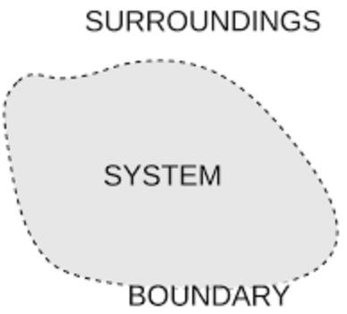
Thermodynamics and the Phase
Rule
Thermodynamic Background
System: The portion of the universe that is
Surroundings: The part of the universe not
being studied.
included in the
system.
Free Energy
Any change in the system involves a transfer of energy
All chemical systems tend naturally toward states of minimum Gibbs
free
energy
2

Slide 2
Gibbs Free
Energy
G =
H
-
TS
•
Where:
✓
G = Gibbs Free Energy
✓
H = Enthalpy (heat content)
✓
T = Temperature in Kelvin
✓
S = Entropy (a measure of randomness)
3

Slide 3
Phase Rule
Phase:
It is defined as “ Physically distinct, homogenous and mechanically
separable part of a system, characterized by certain intensive properties
• An intensive property does not depend on the amount of material present
▪ Examples: Temperature, density, electric or magnetic field strength
”.
(i) A gaseous mixture constitutes a single phase since gases are completely
miscible. Example : Air
(ii) Two or more liquids which are miscible with one another constitute a single
there is no bounding surfaces separating the different liquids.
phase
as
Example : water and alcohol,
(iii) A system consisting of a liquid in system
Example :
chloroform and benzene one phase system.
equilibrium with its vapour constitute a two phase
H2O(l)
H2O(g)

Slide 4
Phase Rule
J. Willard Gibbs enunciated the
phase rule in 1876 on the basis of Thermodynamic principles
➢“Phase rule”
is an important tool used for the quantitative treatment of systems
It enables us to predict the conditions that must be specified for equilibrium.
in equilibrium.
a
system to exhibit
➢ Two or more different phases are present in equilibrium to form
system”. Such system are studied by phase rule.
a
“heterogeneous
➢ This
rule
predicts qualitatively
the
effect of
temperature,
pressure
and
concentration on a heterogeneous equilibrium.

Slide 5
Gibbs phase rule
In a heterogeneous system in equilibrium is not affected by gravity or by electrical and magnetic forces, the number of degrees of freedom(F) of the system is related to the number
“
of component(C) and the number
equilibrium”.
of
phases(P)
existing
at
It
is expressed by mathematically,
F = C – P + 2
where,
F - number of degrees of freedom
C - number of components
P - number of phases
2 - additional variables of temperature
and pressure

Slide 6
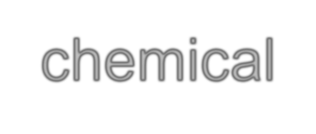
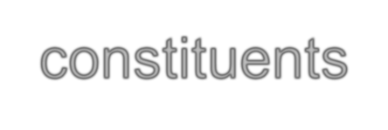
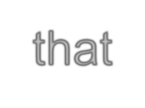

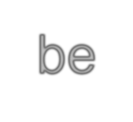
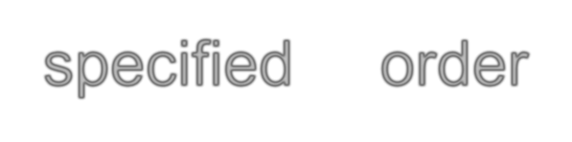


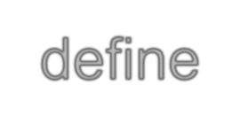

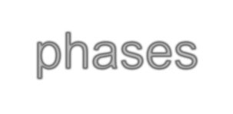
Component
Minimum number of independent variable constituents which are required to express the composition of each phase in the system.
Or
chemical
constituents
that
must
be
fied
in
order
to
e
all
speci
defin
phases
Examples
(ii) Water
system
solid, liquid and vapour
3 components with
1 phase
(C=1 ; P = 3)
.
(iii) Salt +
water system
➢The system is a two component 1 phase .(C=2
, P = 1)

Slide 7
Degrees of Freedom
“Minimum number of independent variables such as temperature, pressure and
concentration which should be specified in order to define the system completely”.
Or the number of intensive parameters that must be
determine the system
specified
in
order
to
completely
Examples
(i)Pure gas can be specified by two variables P and T or P
and V , third variable can be calculated. (C=1 ; P = 1)
F = C – P + 2
Hence pure gas has degree of
freedom
two (F = 2)
(ii)
H2O(l)
H2O(g)
(C=1 ;
P = 2)
(F = 1) Monovariant
(ii) A gaseous mixture say N₂ and O₂ gases is completely defined when three variables(T,P
and C).
(C=2 ; P = 1) (F=3) Trivariant.

Slide 8
F = C – P + 2
(i)The greater the number of components in a system,
greater is
the degree of freedom for a given number of phases.
(ii) The greater the number of phases, the smaller is the number degrees of freedom.
of
(iii) The number of phases is maximum, the
of freedom = Zero, for a given number
number of degrees
of
components.
For
One component system
Two component system
Three component system
P
P P
= 3
= 4
= 5

Slide 9
Phase Rule Advantages
(i) simple method of classifying equilibrium states of systems.
(ii) Confirms that the different systems having the same number of degrees of
freedom behave in same manner.
(iii) Predicts the behavior of the systems with changes in the variables
govern the system in equilibrium
that
(iv) Predicts that,
under a given conditions whether a number of
substances
taken together would remain in equilibrium or it involves in some
interconversion or elimination.
.

Slide 10
Phase Rule Limitations
(i) Not applicable for the systems which
are slow to attain the equilibrium state.
(ii) Does not take in account the electric and magnetic influences.
(iii) All the phases in the system must be present under the same Temperature,
Pressure and Gravitational force .

Slide 11
Phase diagrams
“A phase diagram is the sum
present in equilibrium”
of the description
of the
behavior of the phases
➢ The number of phases that exist in equilibrium depends upon the conditions of
temperature and pressure or temperature and composition, pressure being
constant.
➢ These conditions are determined experimentally and the values of the
variables can be exposed
graphically by using appropriates coordinates.
These diagrams are called phase diagram.

Slide 12
Phase diagrams
One
Component System
From the mathematical expression of phase rule,
F = C – P + 2
When C = 1, P = 1
F = 1-1+2
= 2
All one component systems can be completely described
graphically by
stating only two variables such as
appropriate axis.
pressure
and temperature on

Slide 13
Water System
➢It is a one component system.
➢Water exists in three possible phases viz. ice (solid) , water (liquid),
and vapour
equilibria.
(gas). These
three
single
phases
may
form
four
possible
(i) Solid
(ii) Liquid
(iii) Solid
(iv) Solid
Liquid
Vapour
Vapour
Liquid
Vapour

Slide 14
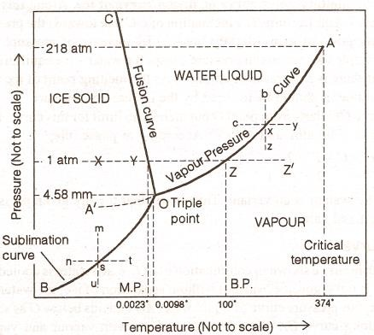
Phase
system
Rule
Phase
Diagram
of
water
(i) Stable curves: three OB, OA and OC
(ii) Metastable curve: one OA'
(iii) Areas: three AOB, COB and AOC
(iv) Triple point: One O

Slide 15
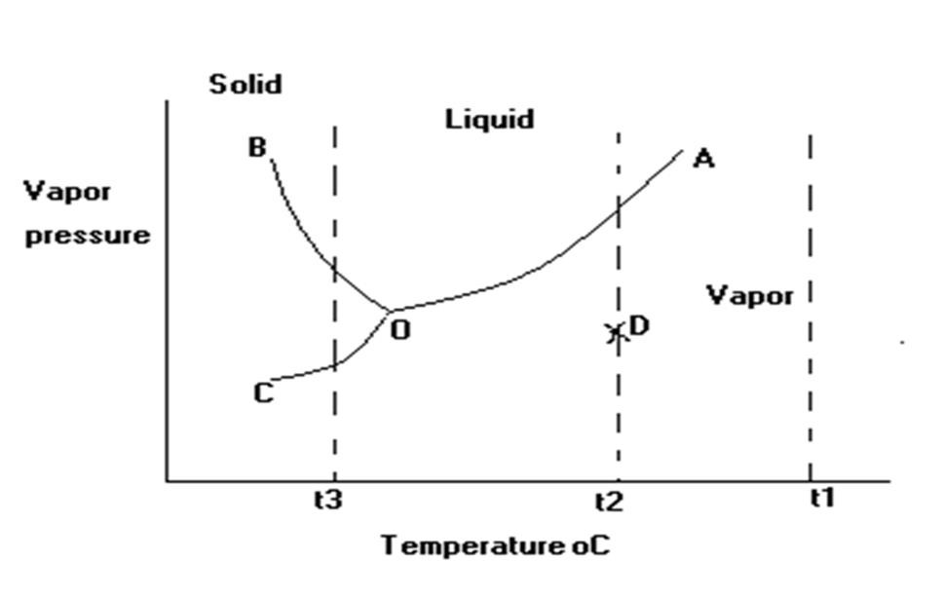
Calculate the
degree
of
freedom
at?
• Point D
F_{D}= 1-1+2= 2
• Point
F_{B} = 1-
B
2 +2=1
• Point
O
FO= 1-3+2= 0
• Point A
F_{A}= 1-2+2= 1

Slide 16
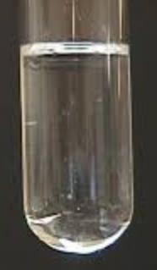
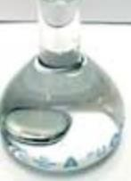
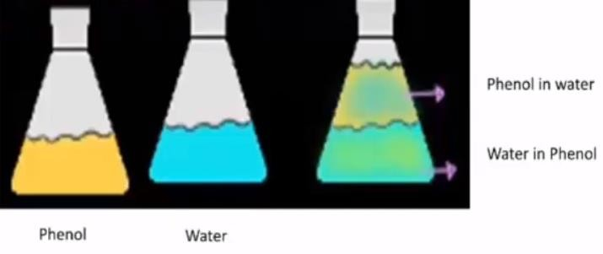
Two component systems containing
liquid
phases
•
Miscible systems such as water and ethanol.
•
Immiscible systems such as water
and
mercury.
•
•
Partial miscibility (or immiscibility)
such as phenol and water.
•
Critical solution temperature:
The maximum
temperature
at
which the two – phase region exists.

Slide 17
Two component systems containing
liquid
phases
•
Phenol and water.
•
These liquids are partially miscible in each other.
•
At certain ratios the liquids are completely miscible
they are immiscible.
and at
others
•
The 2 degrees of freedom of this mixture are temperature
concentration (condensed system).
and

Slide 18
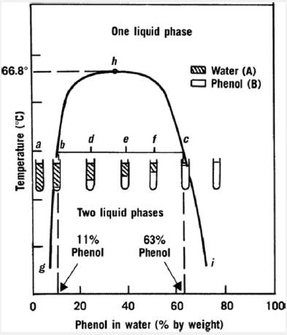
above 66.8°C all
combinations of phenol and
water will be completely
miscible and will be one
phase.
The maximum
temperature that these two liquids can exist in a 2 phase system is
66.8°C.
Critical solution
temperature or the
upper consolute
temperature.
Two liquid phase region:
A region where the two
separated phases appear
with an upper water-rich
layer and lower phenol-rich
layer
20

Slide 19
Once the total
concentration
of phenol
At point b, a
minute amount of
a second phase
appears
(Conjugate Phases)
ex
ceeds 63% at
50ºC, a single
phenol-rich
liquid phase is
formed.
(Conjugate
Phases)
100% water
one phase.
100% Phenol
one phase.
21

Slide 20
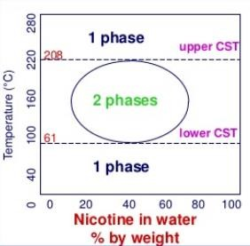
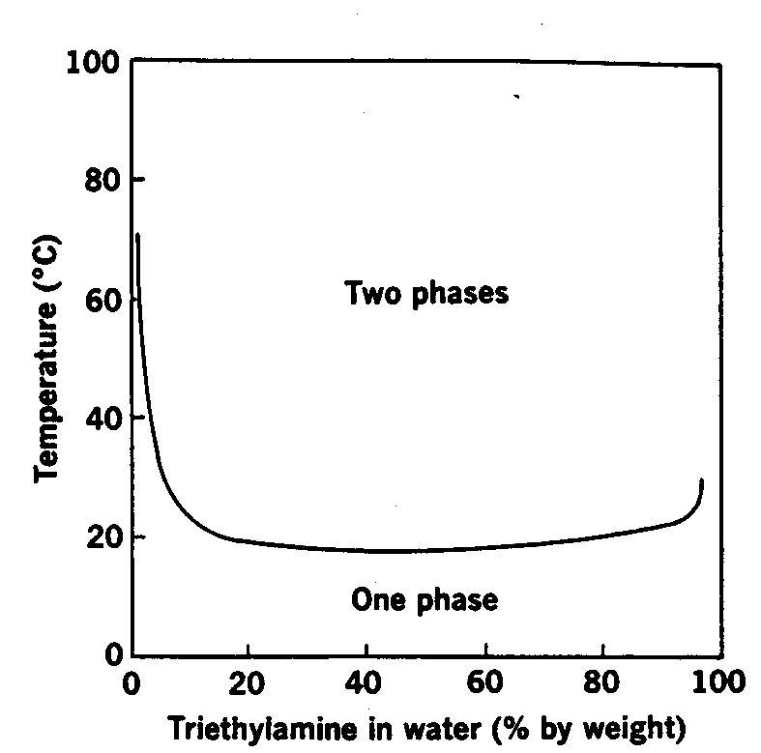
•
Phase
Diagrams
for
Other
Liquid
Binary
Systems
Shows both upper and lower
consolute temperature.
Shows lower consolute temperature

Slide 21
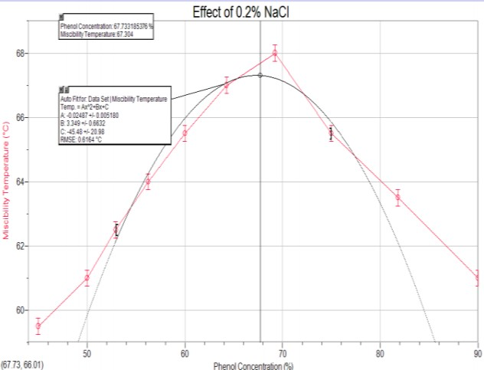
Ternary system
Addition of a substance to a binary liquid system produces a ternary system.
If the added material is soluble in
only
one
of
the
two
components:
•
Adding 0.2 M Sodium chloride to
phenol-water mixture decreases
the solubility between phenol and
water since Sodium chloride
dissolves only in water.
Therefore, the upper consolute
temperature is raised
•

Slide 22
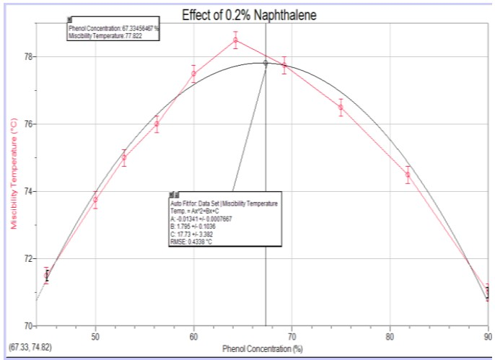
Ternary system
Addition of a substance to a binary liquid system produces a ternary system.
If the added material is soluble
in
only
one
of
the
two
components:
•
Adding
0.2 M naphthalene to
phenol-water mixture decreases
the solubility between phenol
and water since naphthalene
dissolves only in phenol.
Therefore the upper consolute temperature is raised about 20ºC.
•

Slide 23
Ternary system
If the added material is soluble in both of the liquids to the same extent:
• Adding succinic acid or sodium oleate to phenol-water mixture, will dissolve up
to the same extent in both liquids therefore, the solubility of the
increased.
• Therefore, the upper critical solution temperature is lowered.
pair
liquid
is
• The solubility of the pair liquid is increased.
• The increase in solubility of two partially miscible solvents by called blending effect.
another agent is

Slide 24
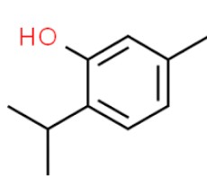
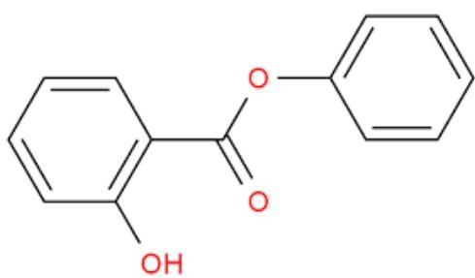
Two component systems containing solid and liquid phases
•
The phase diagram of salol-thymol system is an example of an eutectic mixture.
•
A eutectic system (well melting) is a homogeneous
mixture of substances
that melts or solidifies at a single
temperature
that
is
lower
than
the
melting
point
of
any
of
the constituents.
thymol
salol
Melting point (MP) 41.5 °C
Melting point (MP) 50 °C

Slide 25
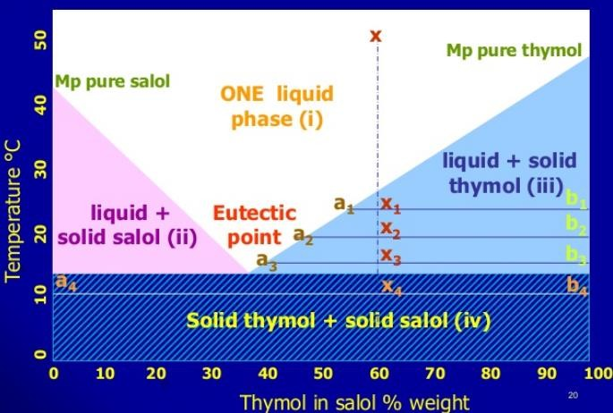
The phase diagram is made of
4 regions:
i.
ii.
A single liquid phase
A region containing solid
salol and a conjugate liquid
phase
A region in which solid
thymol is in equilibrium with
a conjugate liquid phase
A region in which both
components are present as
pure solid phases
iii.
iv.
Eutectic temperature is the temperature at which the three phases co-exist (liquid,
solid salol, and solid thymol).
28

Slide 26
A system of 60% thymol
in
salol:
Temperature of the mixture to 50°C (point
On cooling: single liquid until 29°C at which a minute amount of solid thymol
x).
separates out to form a 2-phase
liquid system.
solid-
At 25°C (x1), liquid phase,
a1 (53% thymol in salol)
and pure solid thymol, b1.
At 20°C (x2), liquid phase,
a2(45% thymol in salol)
and pure thymol b2
29

Slide 27
At 15°C (x3), liquid phase, a3 (37%
thymol in salol and pure thymol
b3.
Below 13°C liquid phase
disappears and the system contains 2 solid phases of pure salol and pure thymol
At 10°C (x4), system contains
an equilibrium mixture of pure solid salol (a4) and pure solid thymol (b4)
30

Slide 28
Thank you

